Slide 1
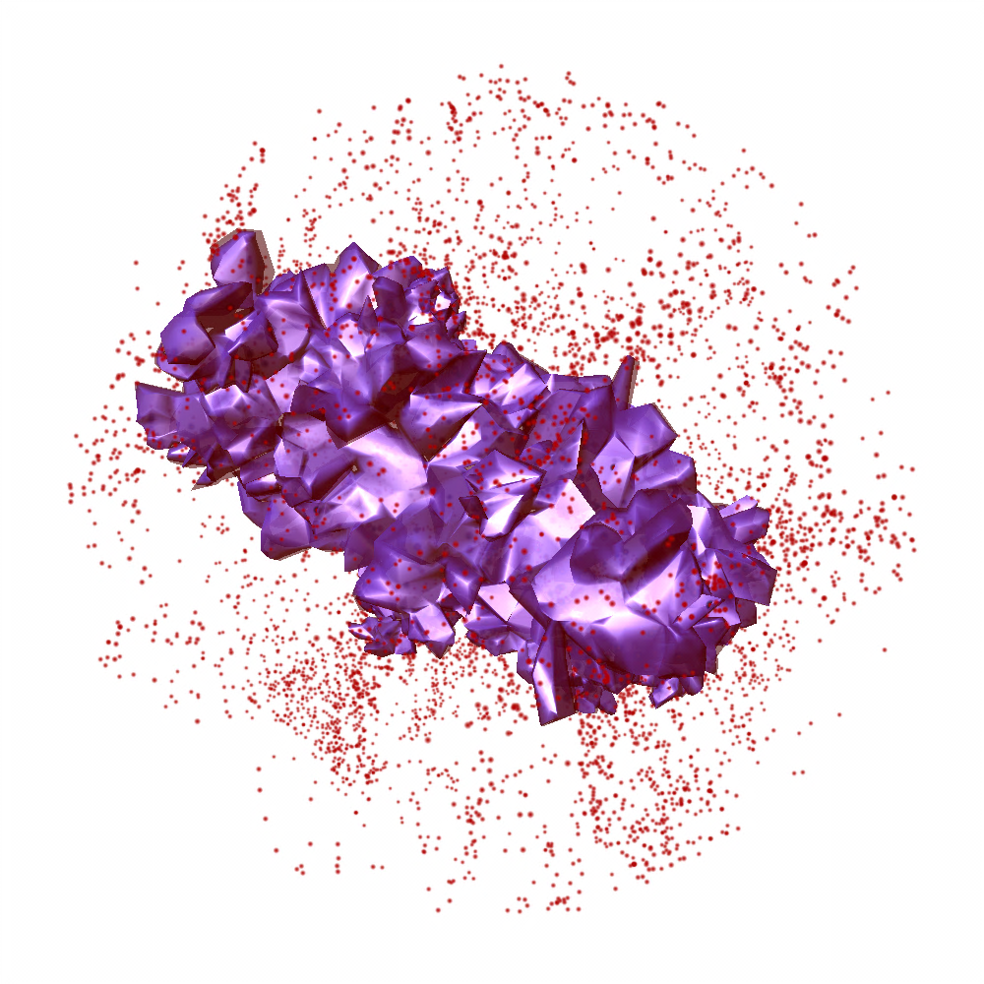
cosmology and astrophysics with cosmic voids
Paul M. Sutter
Paris Institute of Astrophysics/OSU CCAPP
Ben Wandelt,
Guilhem Lavaux, David Weinberg,
Mike Warren, Nico Hamaus, Alice Pisani
sutter@iap.fr
http://www.pmsutter.com

Slide 2
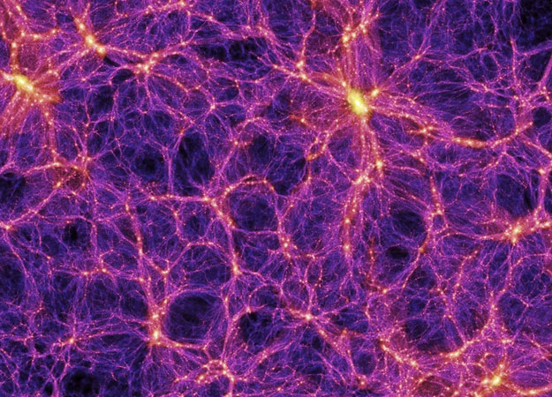
the cosmic web
cluster
you are here?
filament
void

Slide 3
what is a void?

Slide 4
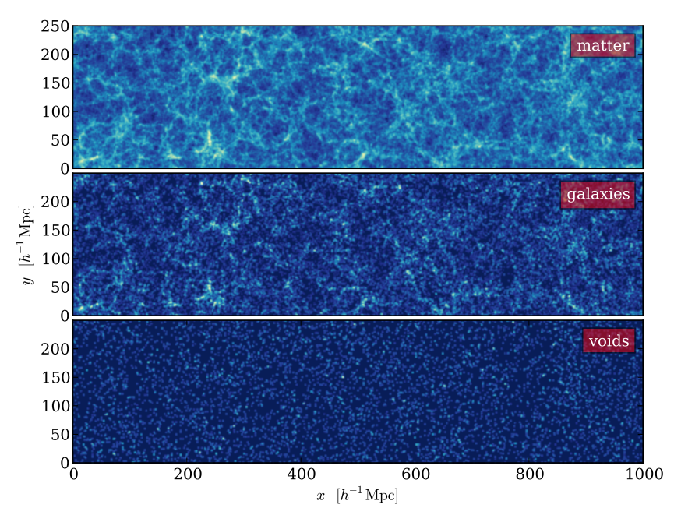
what is a void?
(Hamaus et al. 2013)

Slide 5
why voids?
they’re empty!

Slide 6
why not voids?
they’re empty!

Slide 7
why are voids interesting
size distributions (Lee & Park 2006)
ellipticity distributions (Bos et al. 2012)
Alcock-Paczynski test (Sutter et al. 2012)
integrated Sachs-Wolfe effect (Planck Collaboration 2013)
fifth forces and f(R) gravity (Li et al. 2012)
environmental dependence of galaxy metallicities (Hoeft et al. 2006)
origins of large-scale magnetic fields (Neronov & Vovk 2010)
weak anti-lensing (Melchior et al. 2013)
Lyα (Tejos et al. 2012)
standard rulers (Hamaus et al. 2013)

Slide 8
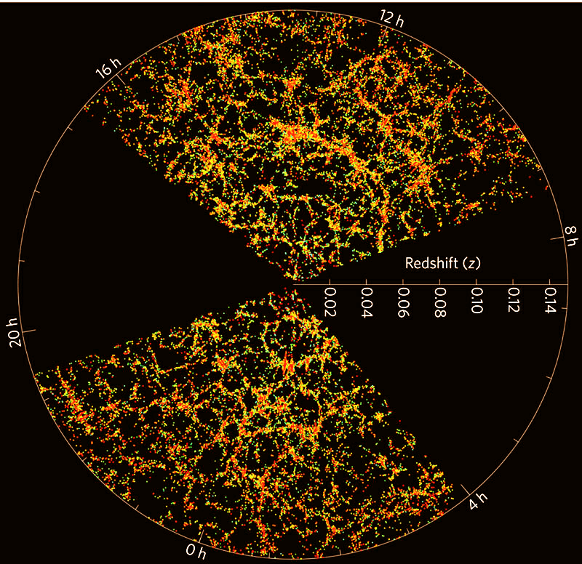
where are the voids?

Slide 9
how to find voids?
galaxy survey/simulation
Voronoi tessellation
watershed transform
voids!

Slide 10
tessellation: filling space with shapes

Slide 11
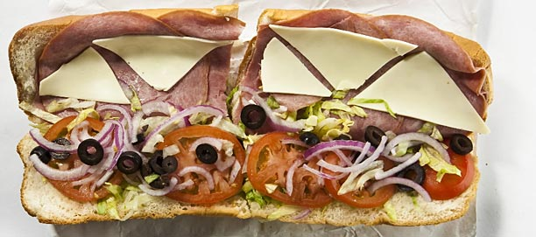
tessellation: filling space with shapes

Slide 12
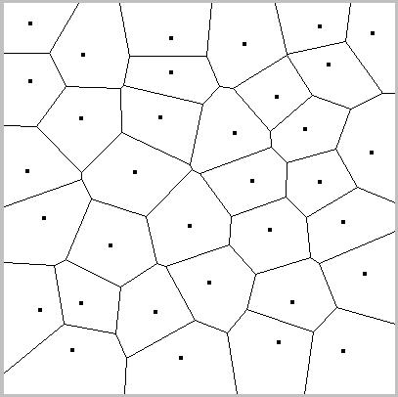
the Voronoi tessellation

Slide 13
watershed transform finds peaks and valleys
ridgeline
ridgeline
basin

Slide 14
watershed transform finds peaks and valleys
ridgeline
ridgeline
basin

Slide 15
watershed transform finds peaks and valleys
cluster
filament
void

Slide 16
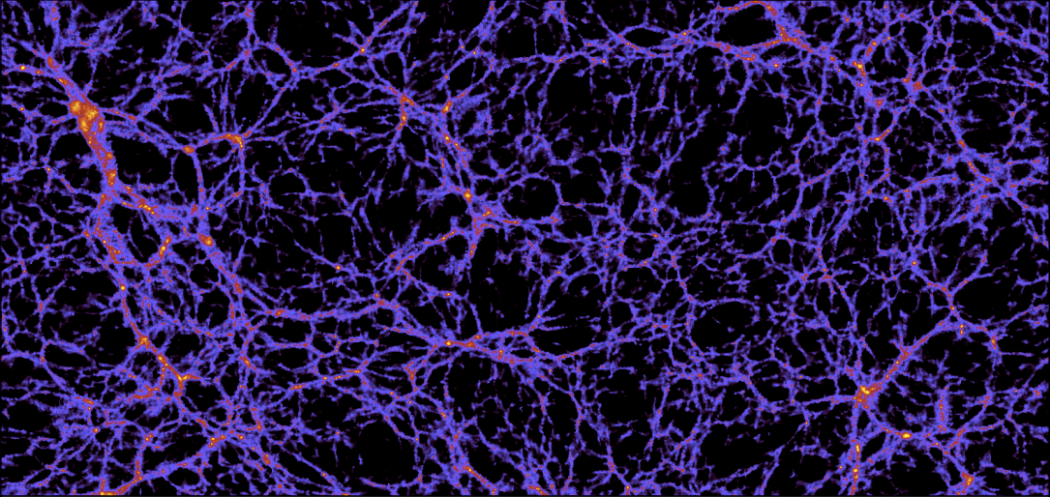
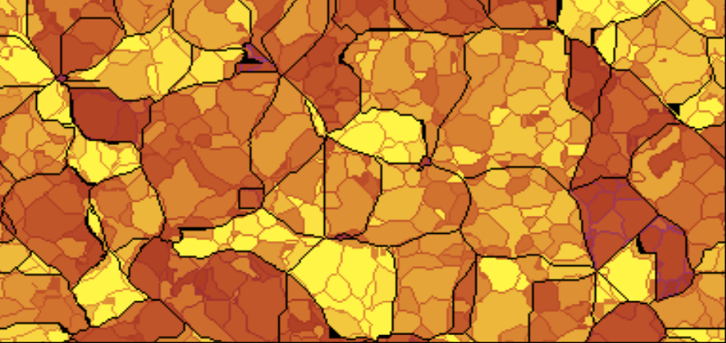
a hierarchy of voids
(Bos et al. 2012)

Slide 17
what a void looks like
(Sutter et al. 2012)

Slide 18
void movie!

Slide 19
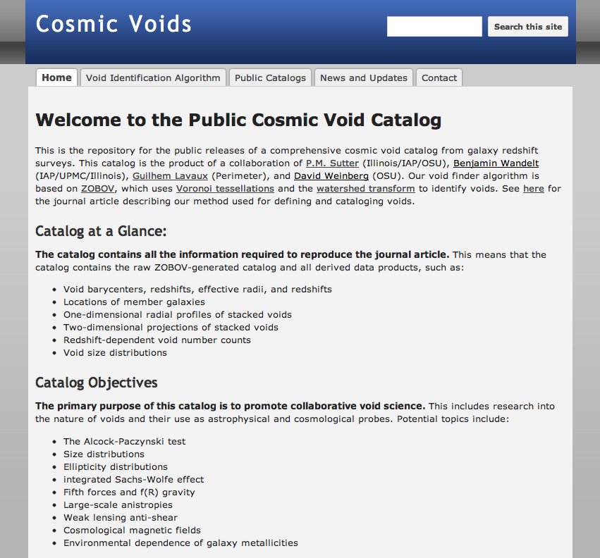
public catalog
http://www.cosmicvoids.net

Slide 20
looking inside a galaxy void
low-density survey
high-density survey
(Sutter et al. 2013)

Slide 21
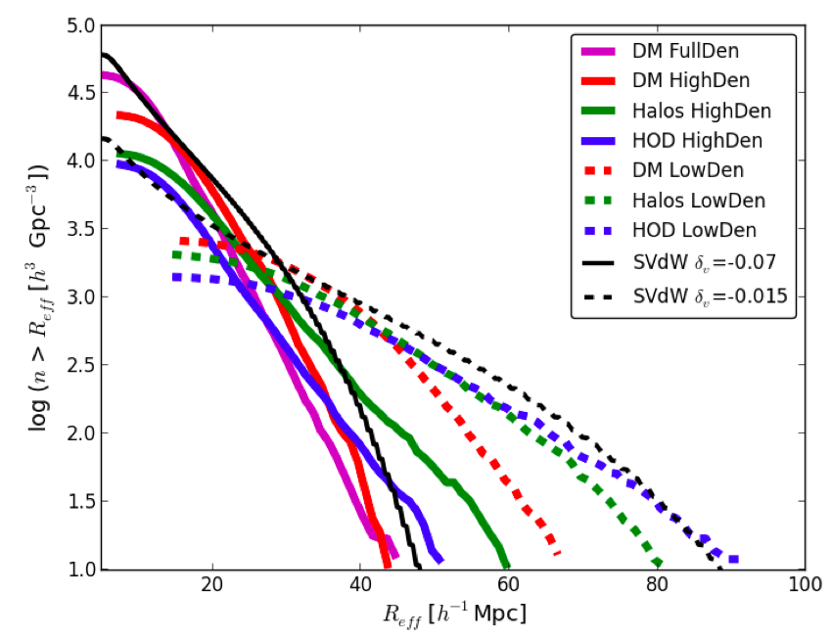
from galaxy voids to dark matter underdensities
(Sutter et al. 2013)

Slide 22
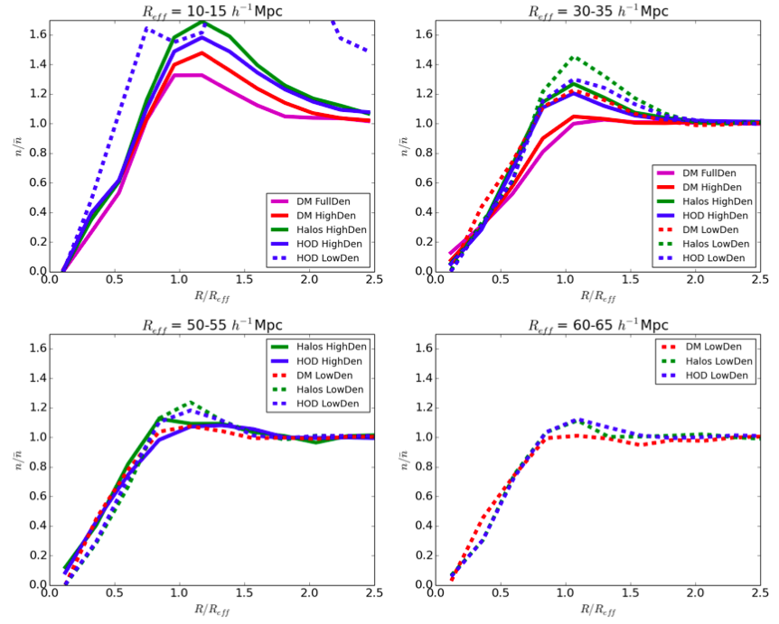
a universal density profile?
(Sutter et al. 2013)

Slide 23
why are voids interesting
size distributions (Lee & Park 2006)
ellipticity distributions (Bos et al. 2012)
Alcock-Paczynski test (Sutter et al. 2012)
integrated Sachs-Wolfe effect (Planck Collaboration 2013)
fifth forces and f(R) gravity (Li et al. 2012)
environmental dependence of galaxy metallicities (Hoeft et al. 2006)
origins of large-scale magnetic fields (Neronov & Vovk 2010)
weak anti-lensing (Melchior et al. 2013)
Lyα (Tejos et al. 2012)
standard rulers (Hamaus et al. 2013)

Slide 24
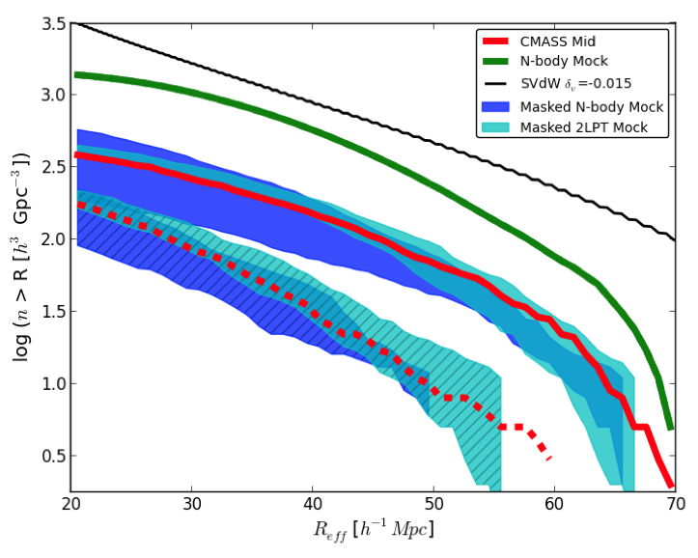
void application: number counts
(Sutter et al. 2013)

Slide 25
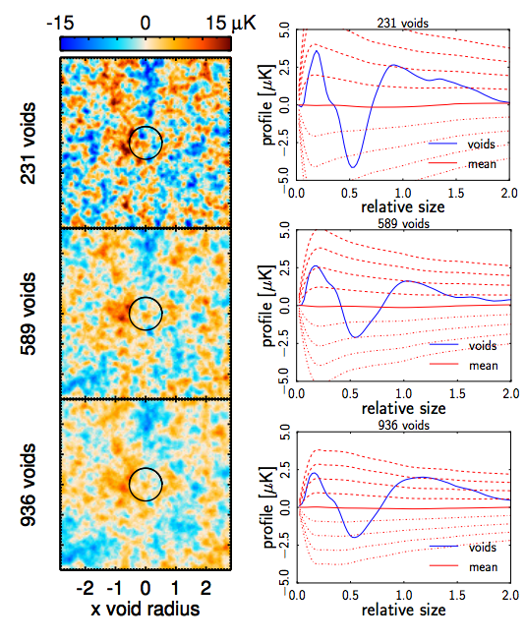
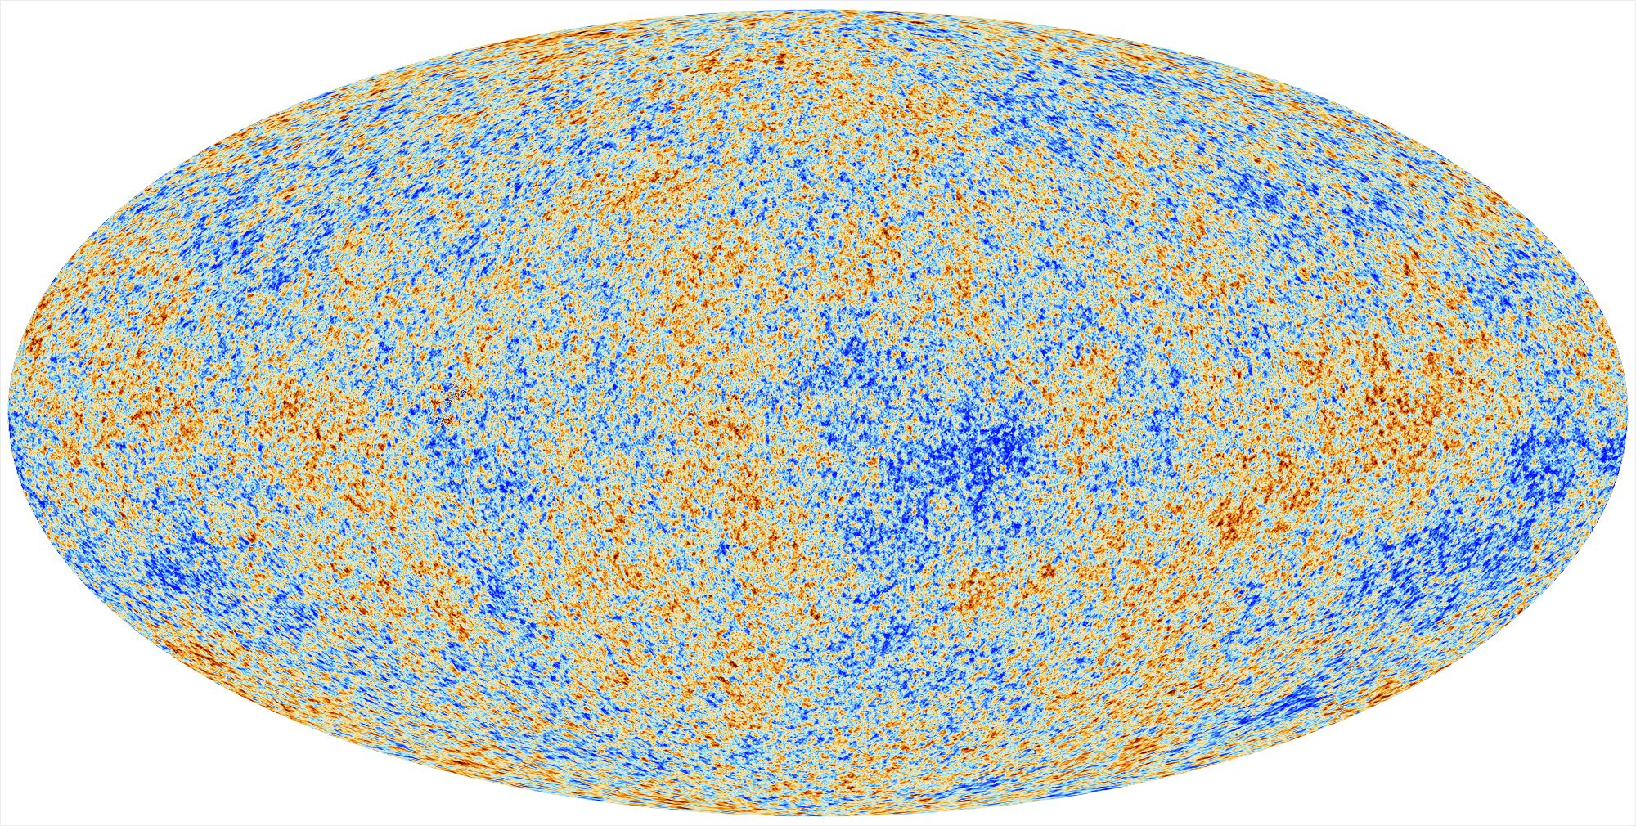
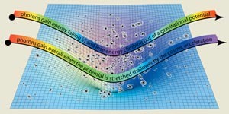
void application: ISW
(Planck Collaboration 2013)

Slide 26
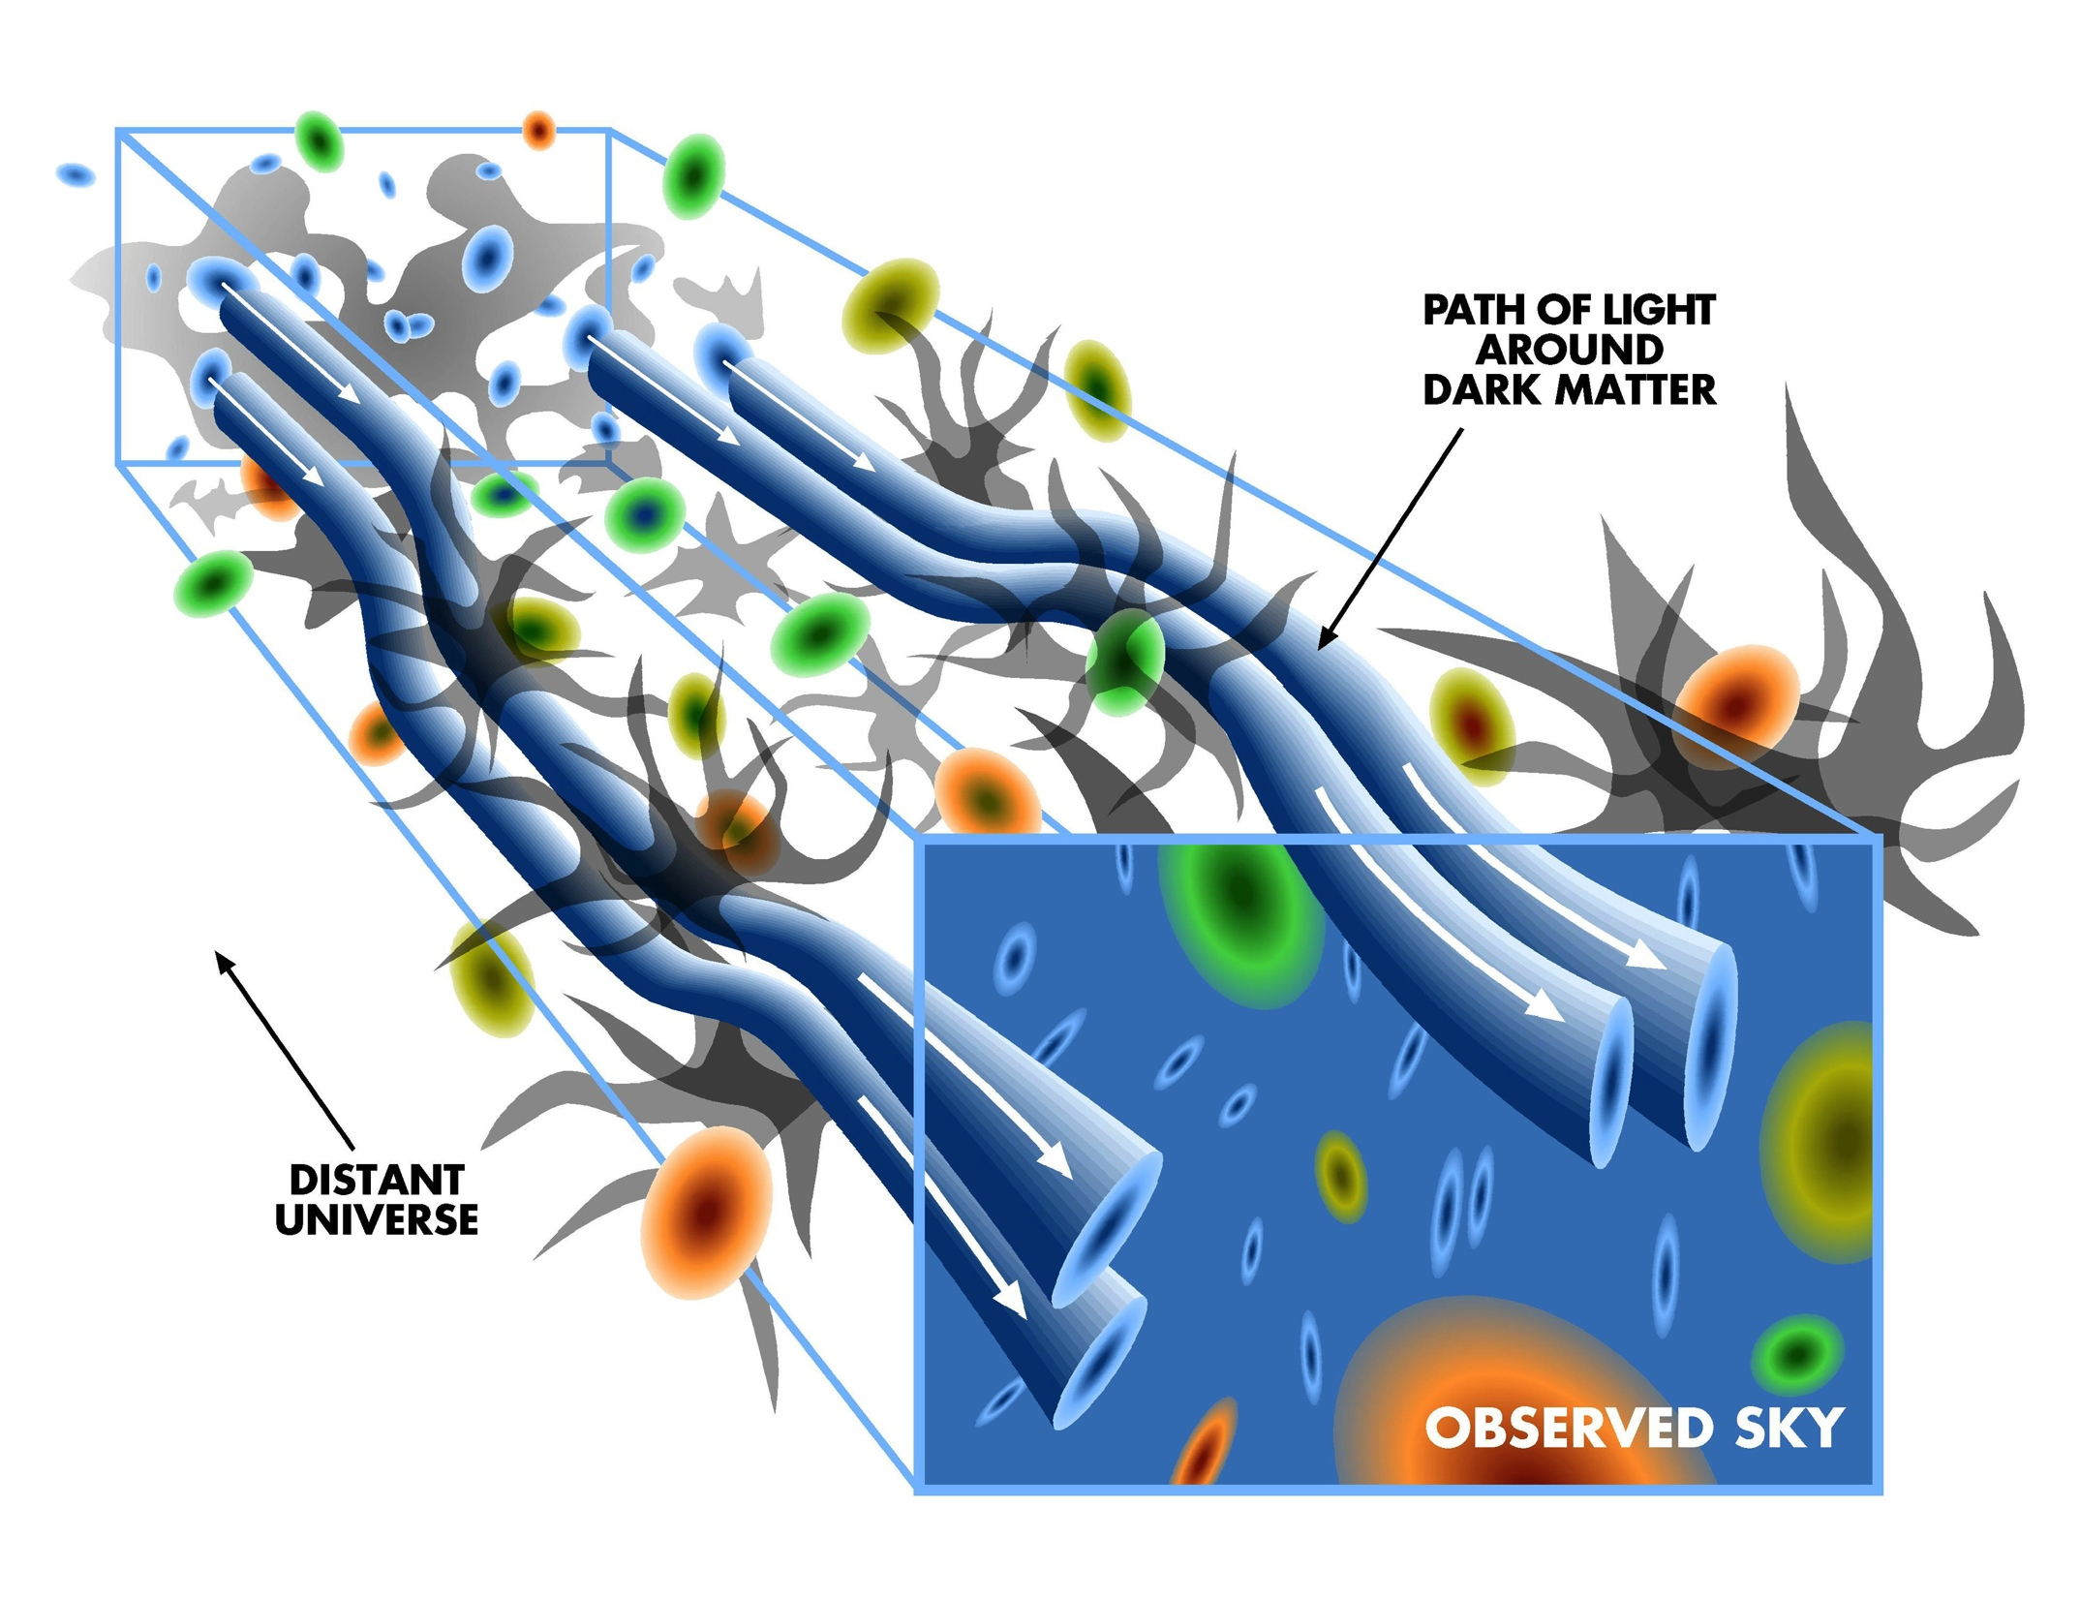
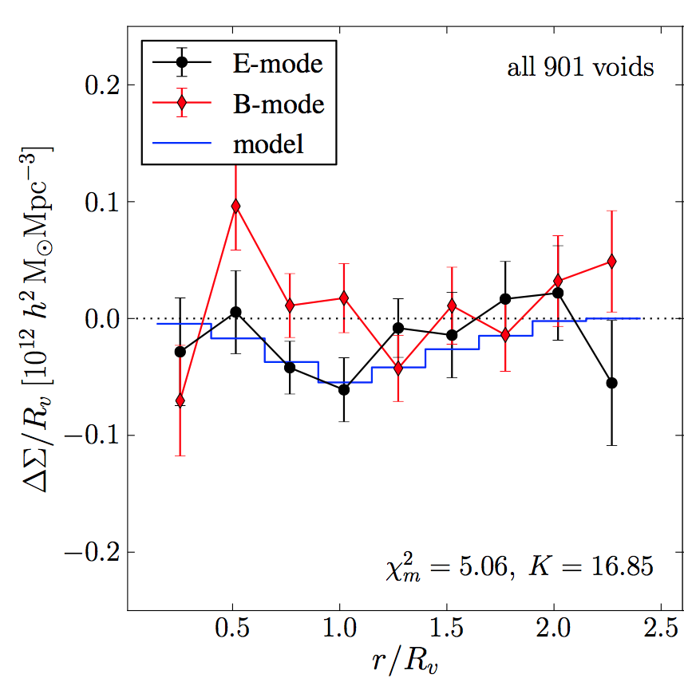
void application: anti-lensing
(Melchior et al. 2013)

Slide 27
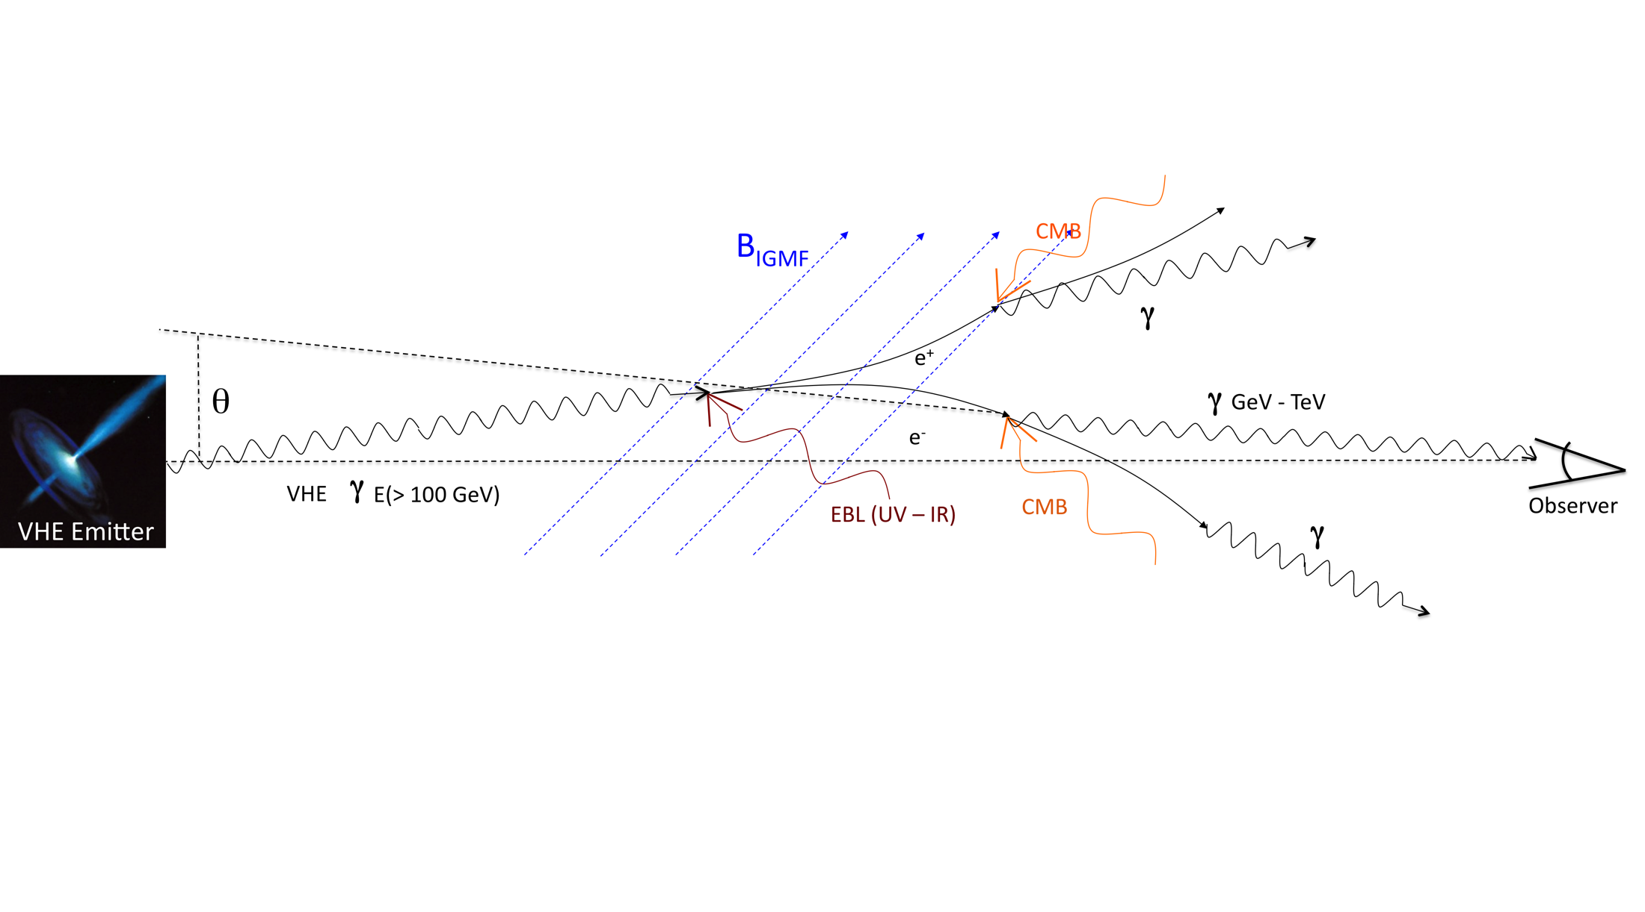
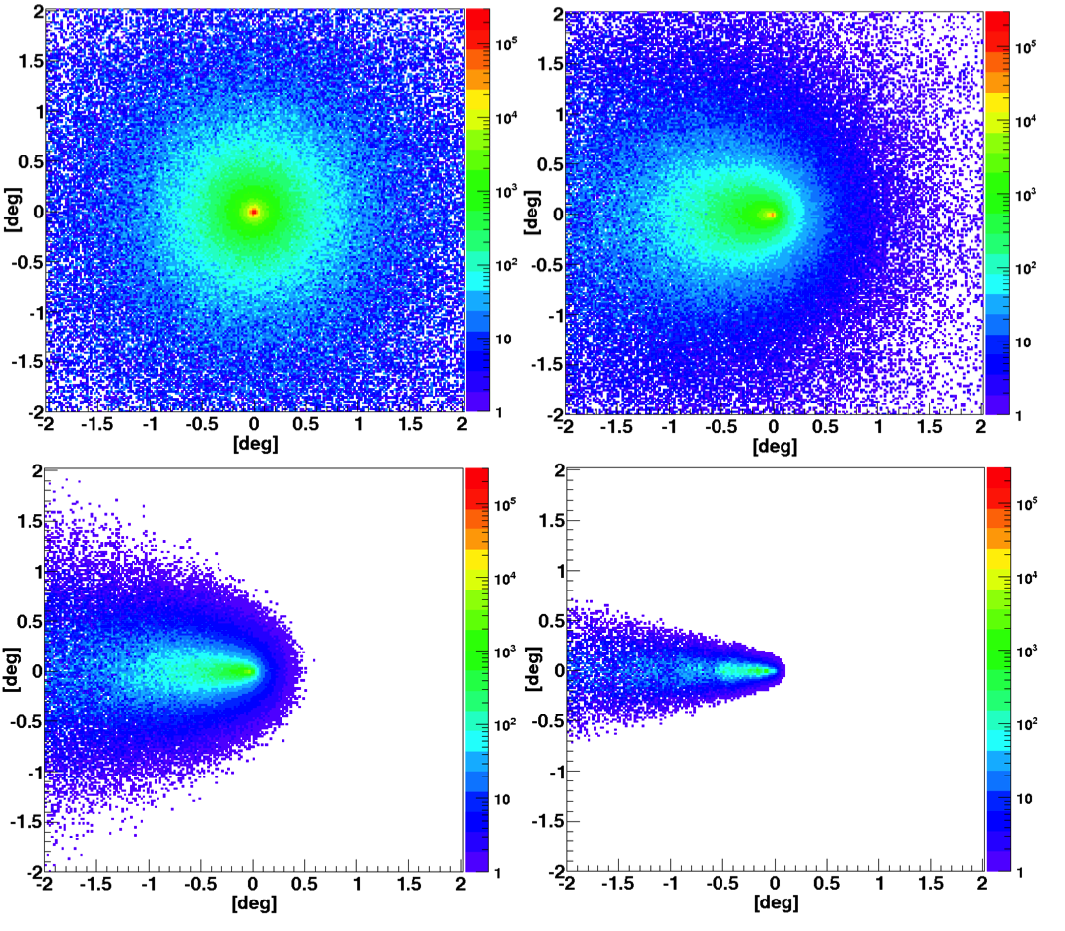
void application: magnetic fields
(Arlen et al. 2012)

Slide 28
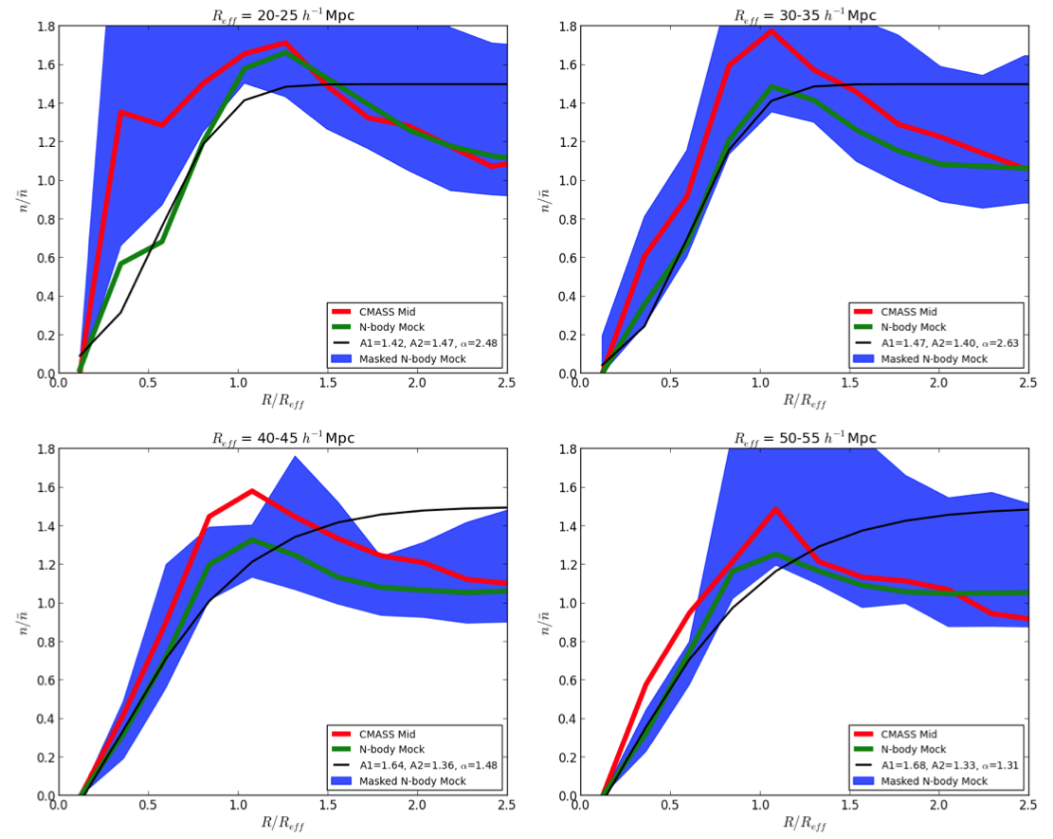
void application: neutrinos/fifth forces?
(Sutter et al. 2013)

Slide 29
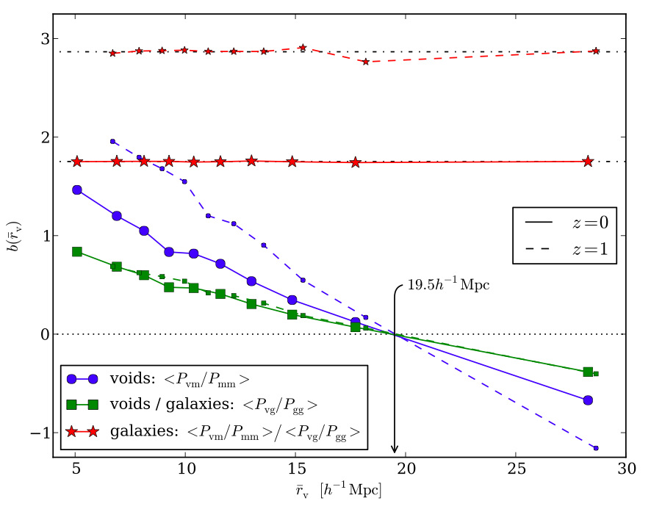
void application: standard rulers
(Hamaus et al. 2013)

Slide 30
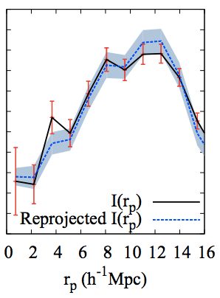
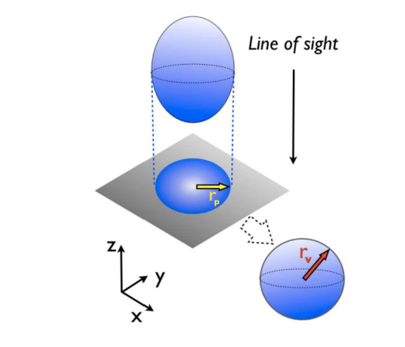
p.s.: measuring the density profile
(Pisani et al. 2013)

Slide 31
why are voids interesting
size distributions (Lee & Park 2006)
ellipticity distributions (Bos et al. 2012)
the Alcock-Paczynski test (Sutter et al. 2012)
integrated Sachs-Wolfe effect (Granett et al. 2008)
fifth forces and f(R) gravity (Li et al. 2012)
environmental dependence of galaxy metallicities (Hoeft et al. 2006)
origins of large-scale magnetic fields (Neronov & Vovk 2010)
weak anti-lensing (Melchior et al. 2012)
Lyα (Tejos et al. 2012)

Slide 32
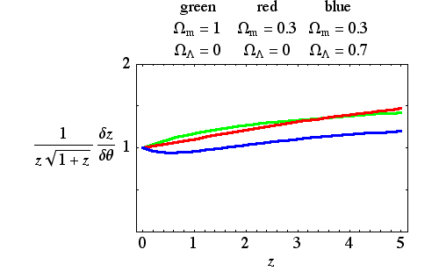
the alcock-paczynski test probes cosmology
(Alcock & Paczynski 1979)
z
θ

Slide 33
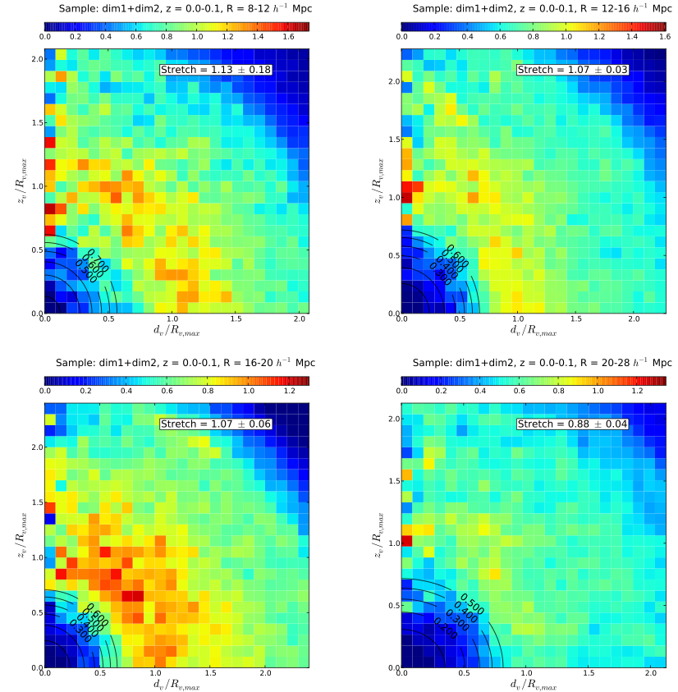
saved by stacking
(Sutter et al. 2012)

Slide 34
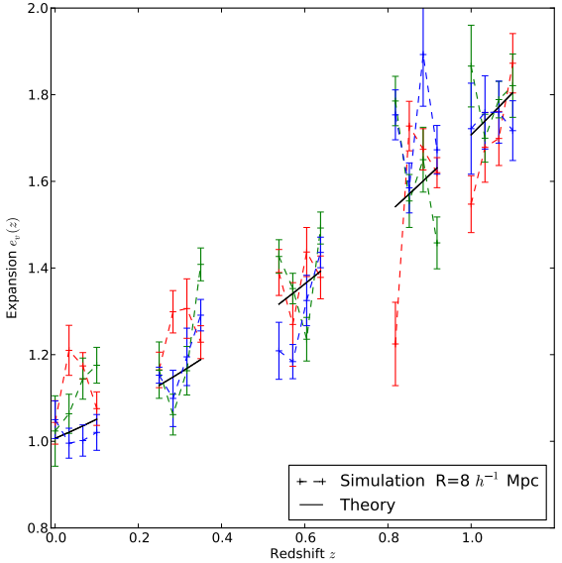
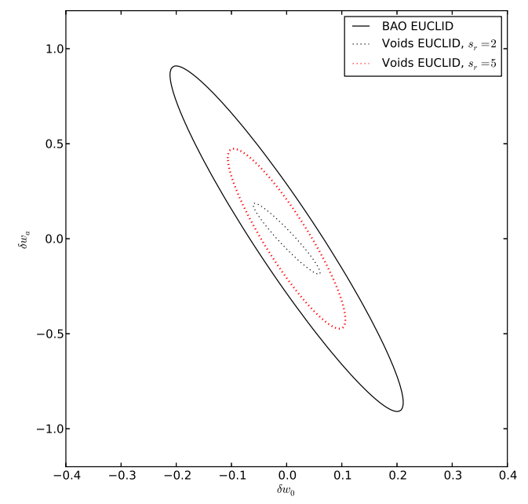
voids promising for dense surveys
(Lavaux & Wandelt 2012)

Slide 35
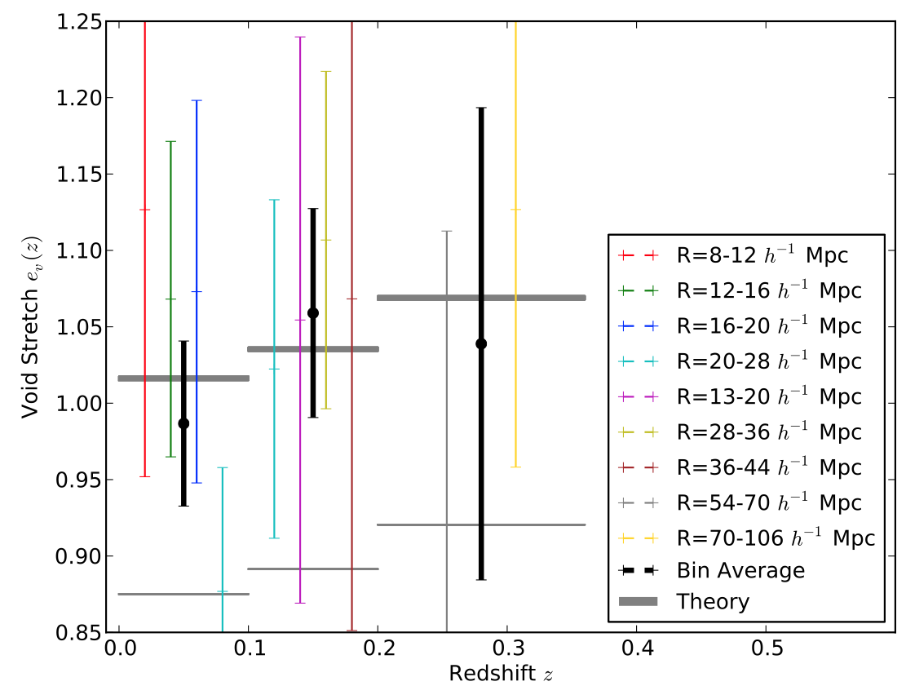
the DR7 A-P result
(Sutter et al. 2012)

Slide 36
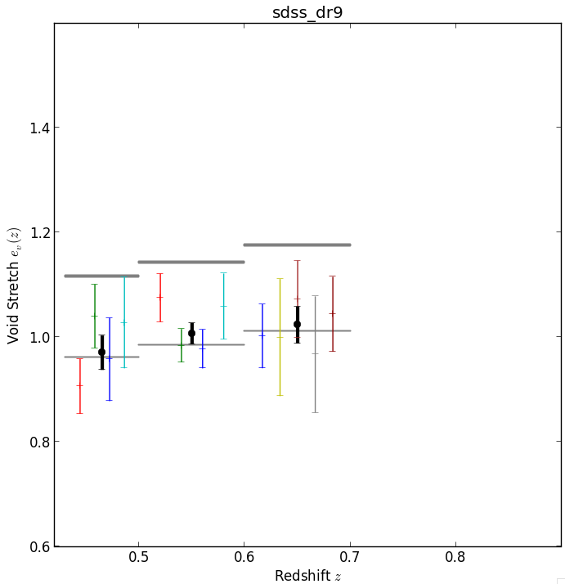
DR9 first results
PRELIMINARY

Slide 37
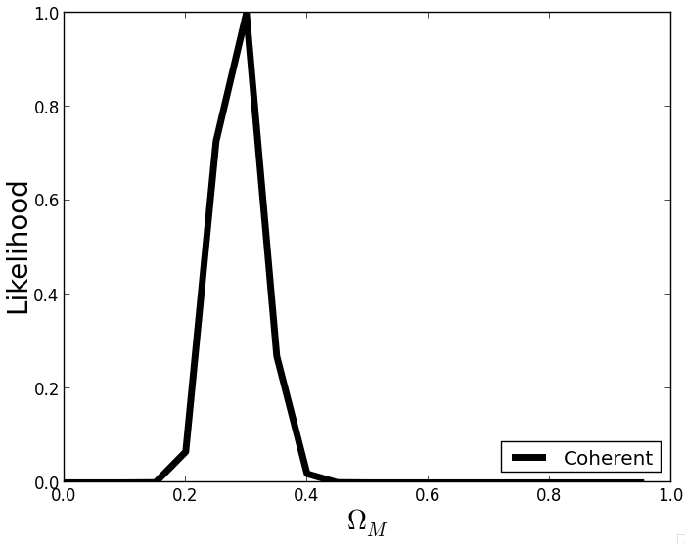
DR9 first results
PRELIMINARY

Slide 38
the future of voids
robust void determination
public void catalog
fundamental and derived void properties available
hints of A-P signal in SDSS
building bridge between theory and observations
many exciting void projects
more info at cosmicvoids.net
sutter@iap.fr
http://www.pmsutter.com

Slide 39
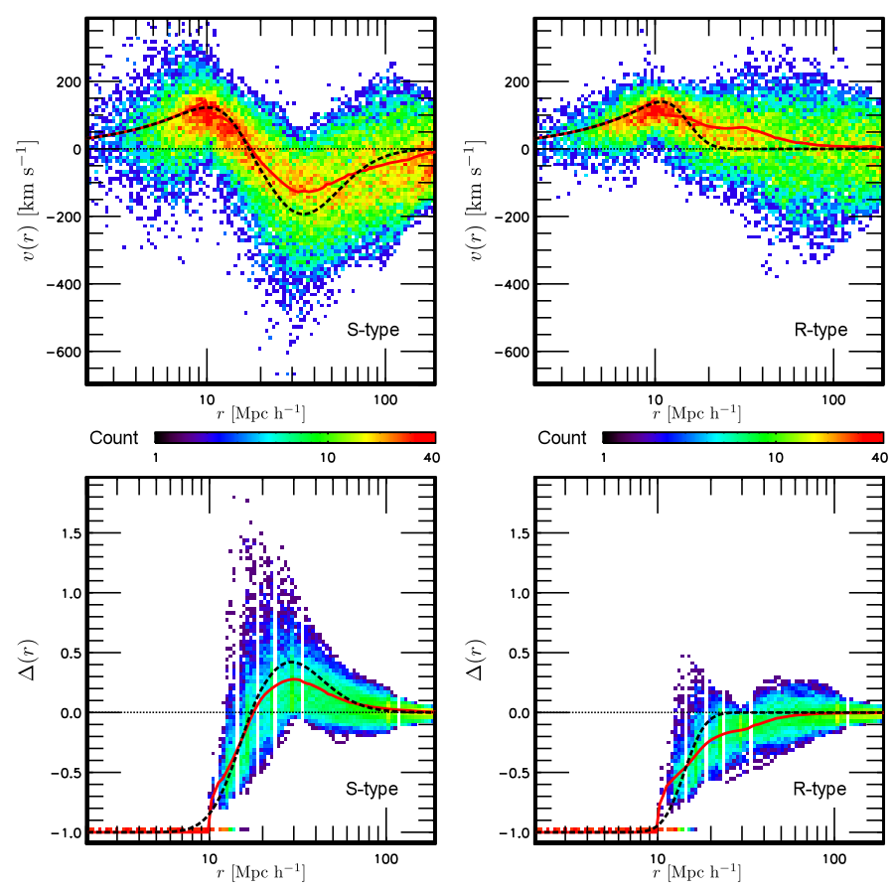
what is a void?
(Paz et al. 2013)

Slide 40
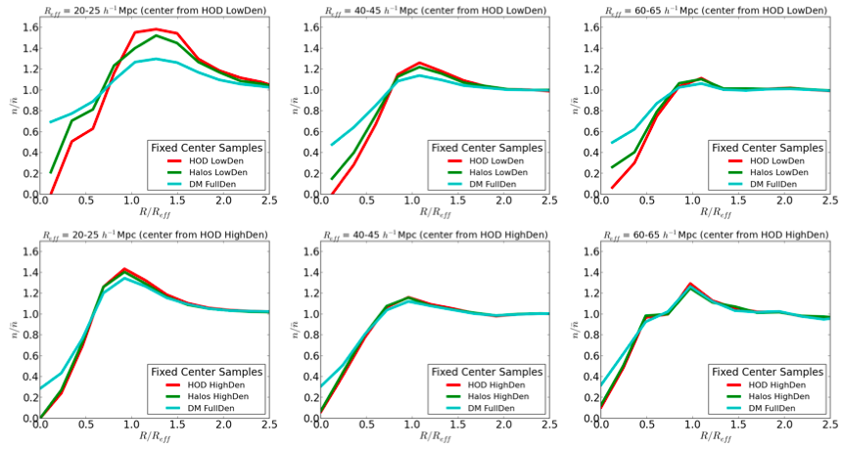
looking inside a galaxy void

Slide 41
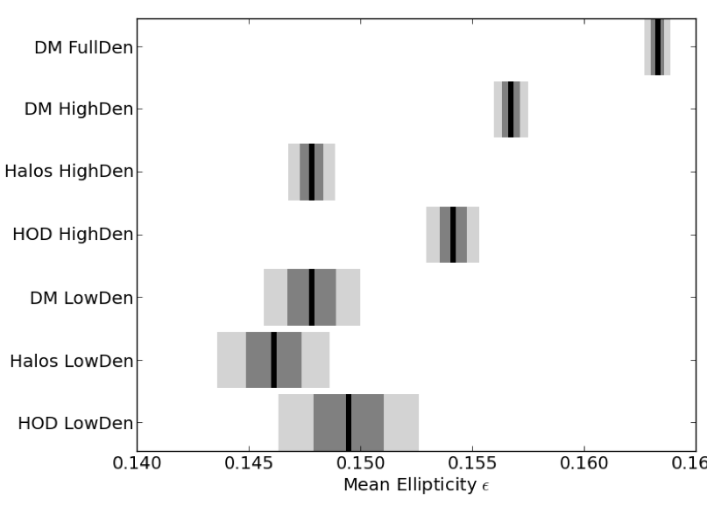
from galaxy voids to dark matter underdensities

