Slide 1


Hunting down the acoustic scale after the cosmic high noon
Francisco Prada
Instituto de Física Teórica UAM-CSIC, Madrid
In collaboration with Yepes, Scoccola, Klypin, Chuang,
Hess, Gottloebr & Kitaura.
Berkeley, January 31th, 2014

Slide 2
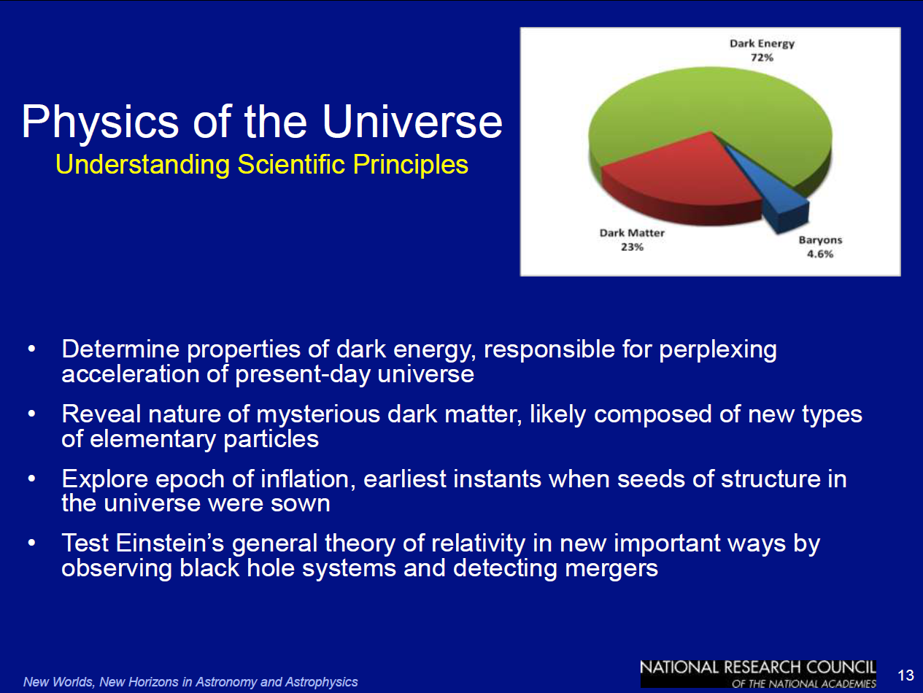
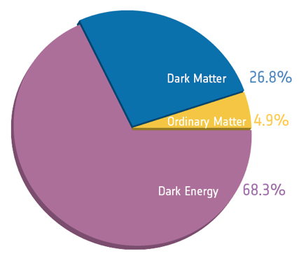
Top Scientific Objectives
The two highest level questions in the field are the following:
Is cosmic acceleration caused by a breakdown of Einstein General Relativity on cosmological scales, or is it caused by a new energy component with negative pressure ("dark energy") within General Relativity?
If the acceleration is caused by "dark energy," is its energy density constant in space and time and thus consistent with quantum vacuum energy or does its energy density evolve in time and/or vary in space?

Slide 3
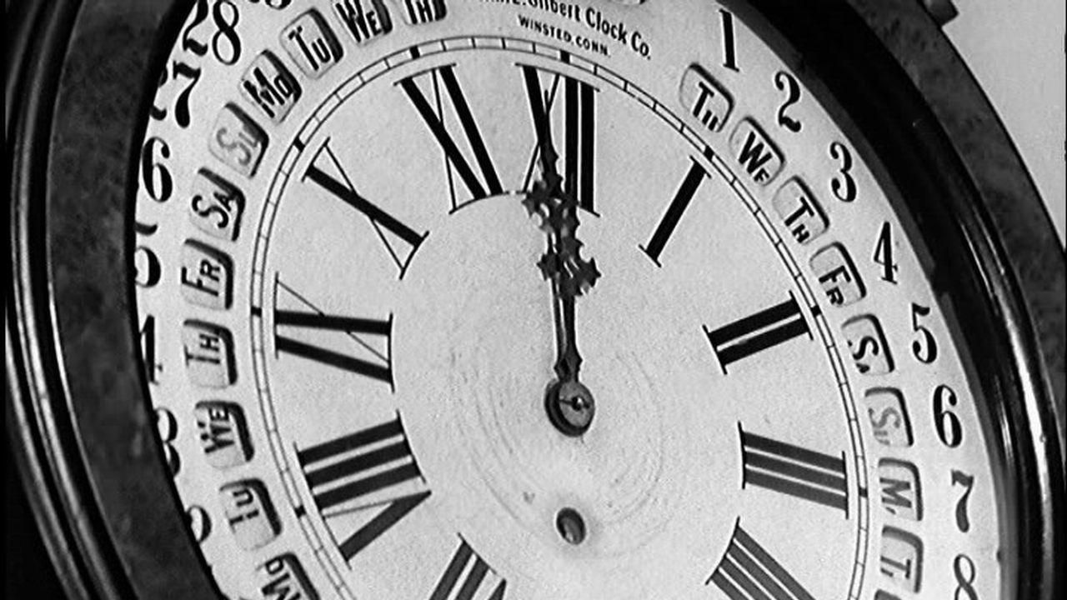
Dark Energy racing season has started!

Slide 4
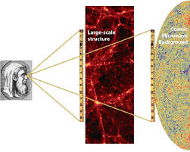
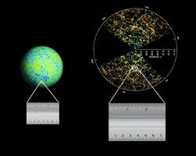
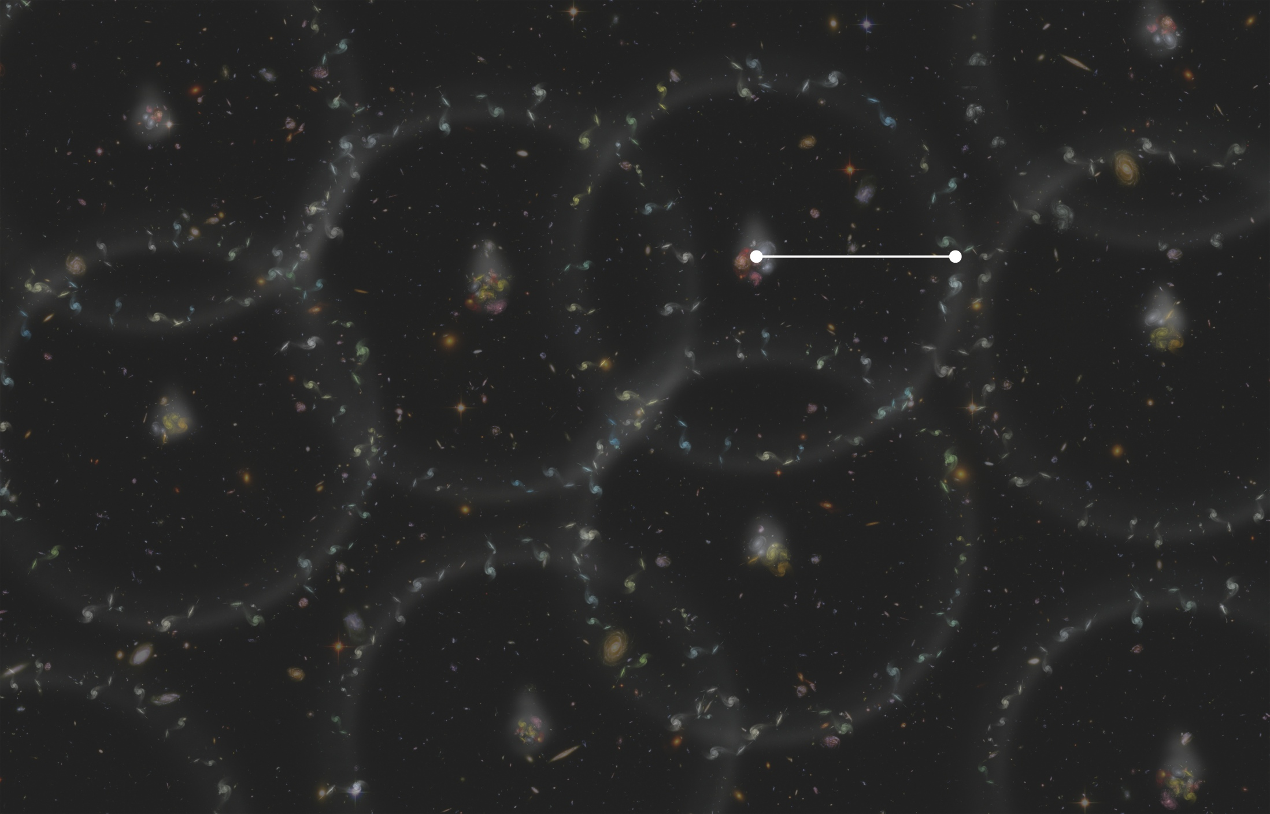

How to measure Dark Energy?
Baryonic Acoustic Oscillations as standard ruler
LSS catalogs provides a picture
of the distribution of matter such that
one can search for a BAO signal by
seeing if there is a larger number of
galaxies separated at the sound horizon.

Slide 5
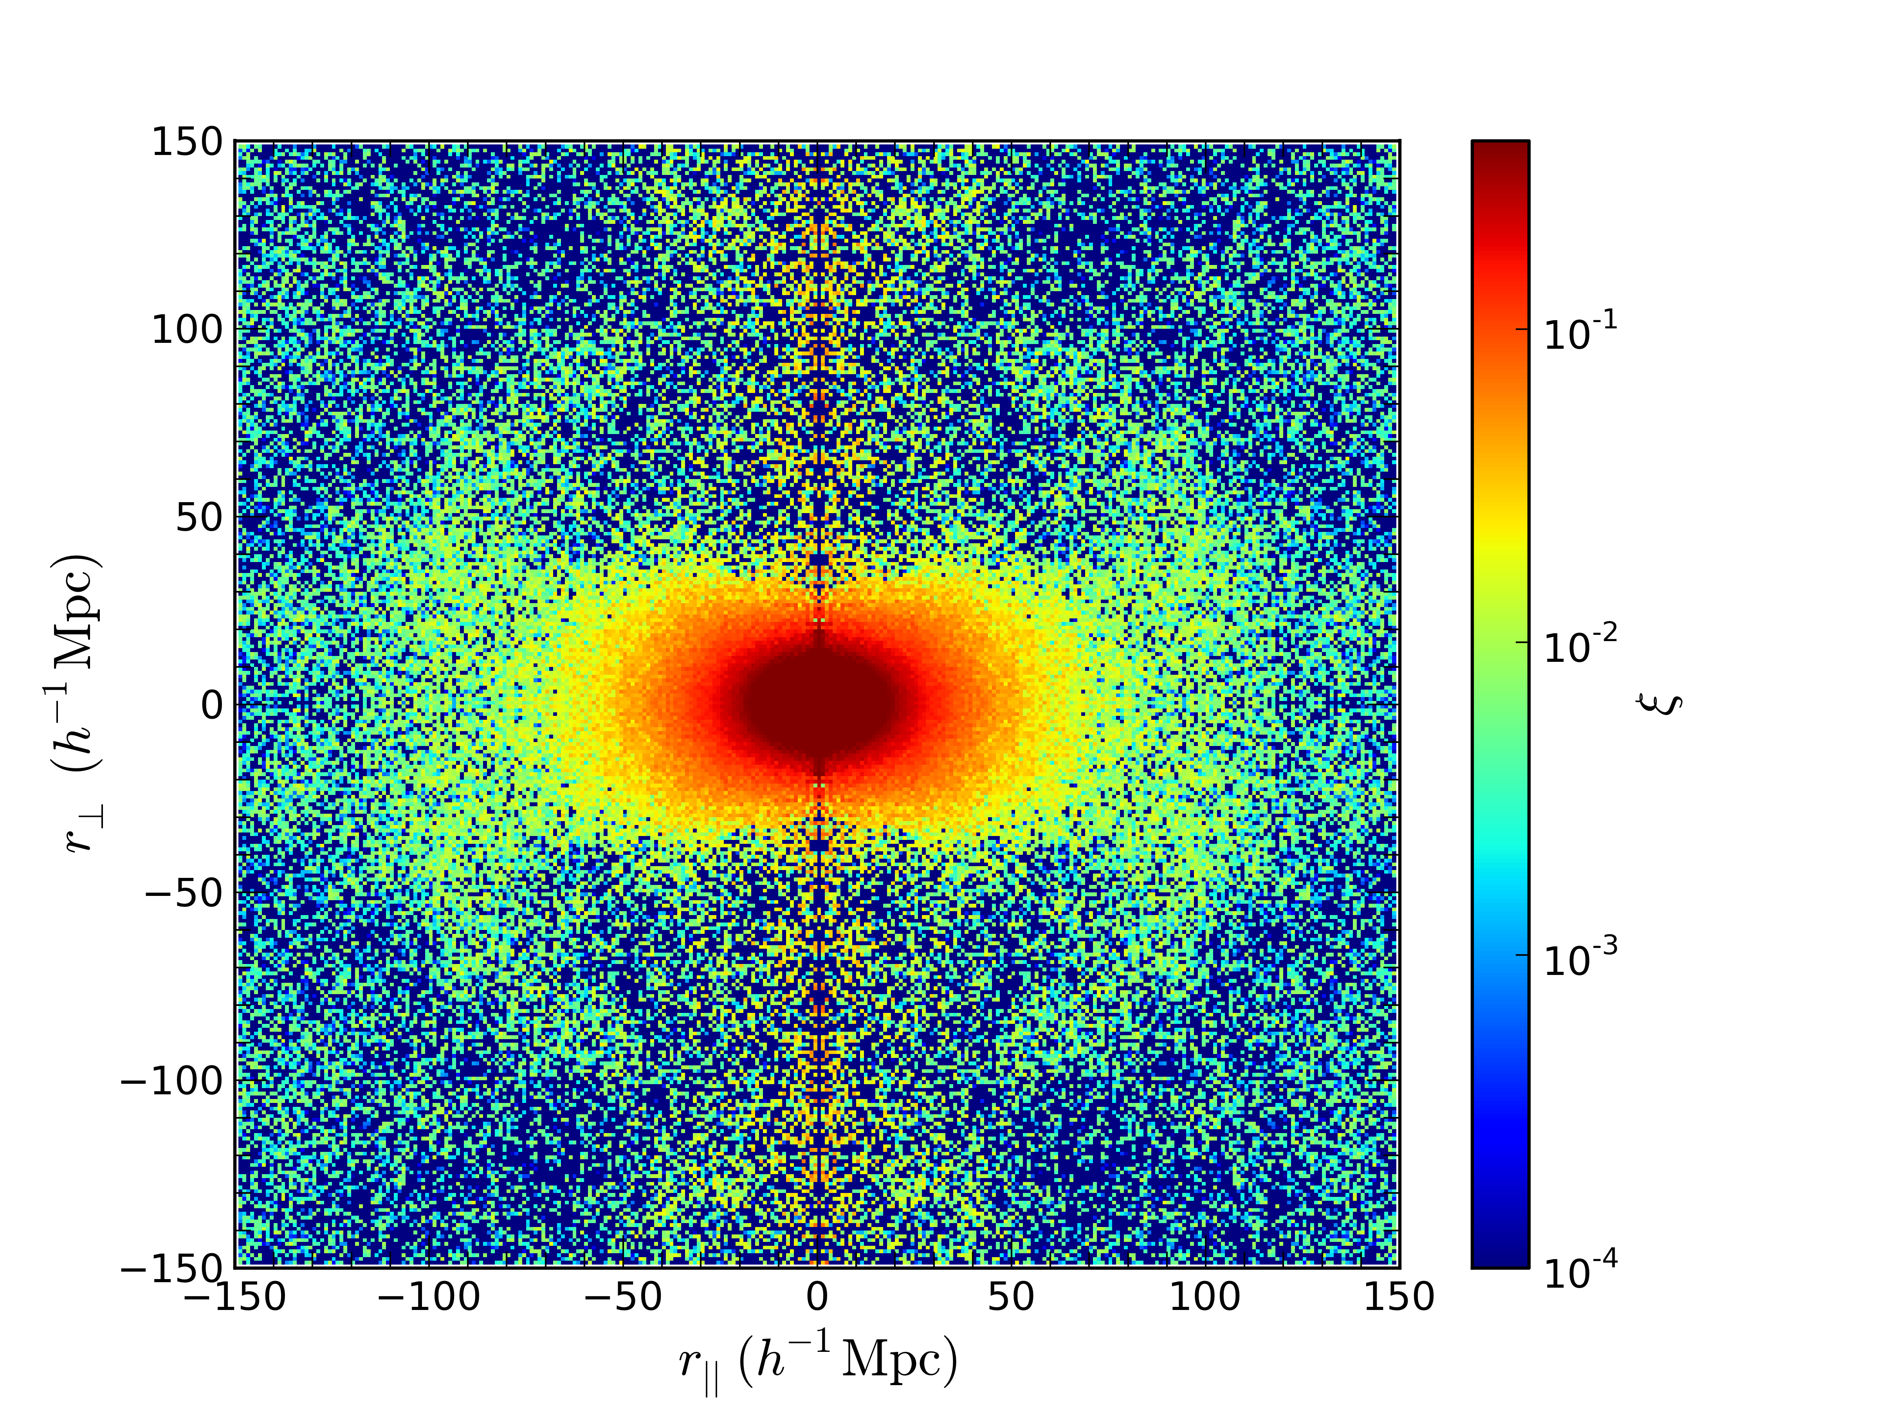

Baryonic Acoustic Oscillations
BAO feature in both the transverse and
line-of-sight directions. These shifts are typically parameterized by
Together, they allow us to measure the
Angular diameter distance (relative to
the sound horizon at the drag epoch
r_{d}) D_{A}(z)/r_{d}, and the Hubble parameter
H(z) via cz/(H(z) r_{d}) separately.
Two-dimensional correlation function
of DR11 CMASS galaxies in BOSS.
Colors indicate amplitude of the
correlation function (Samushia et al. 2013)

Slide 6
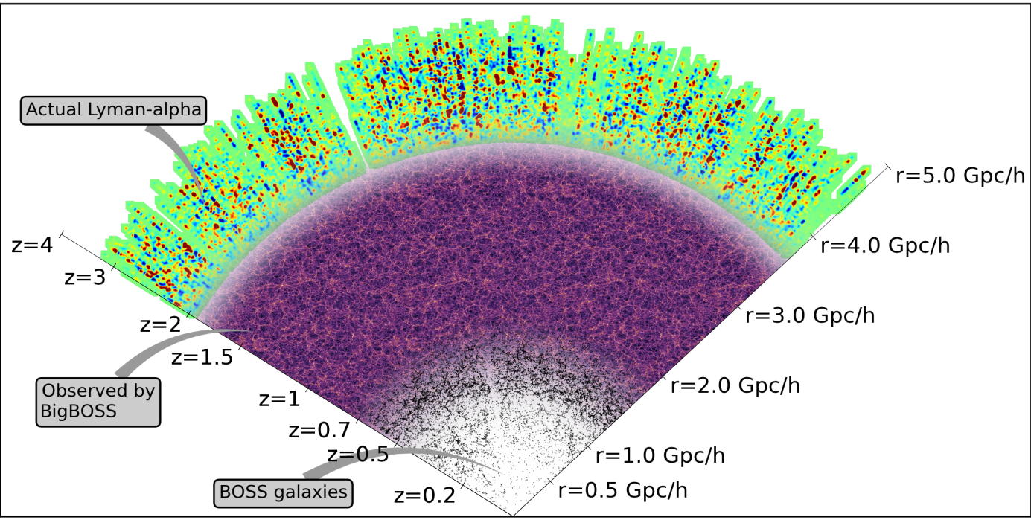
Large Scale Structure Spectroscopic Surveys

Slide 7
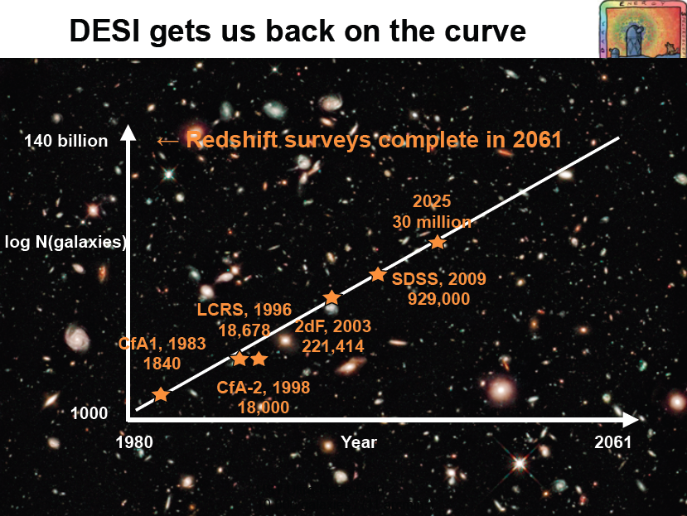


Slide 8
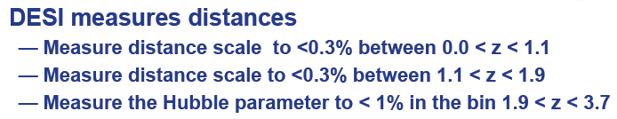
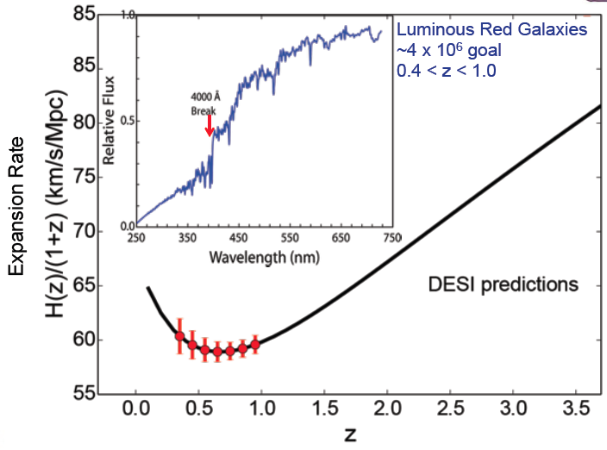
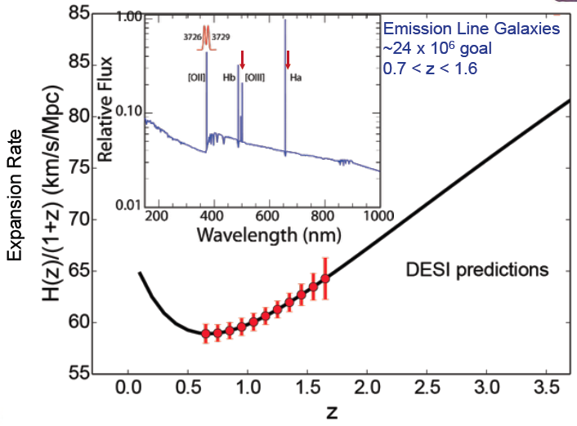
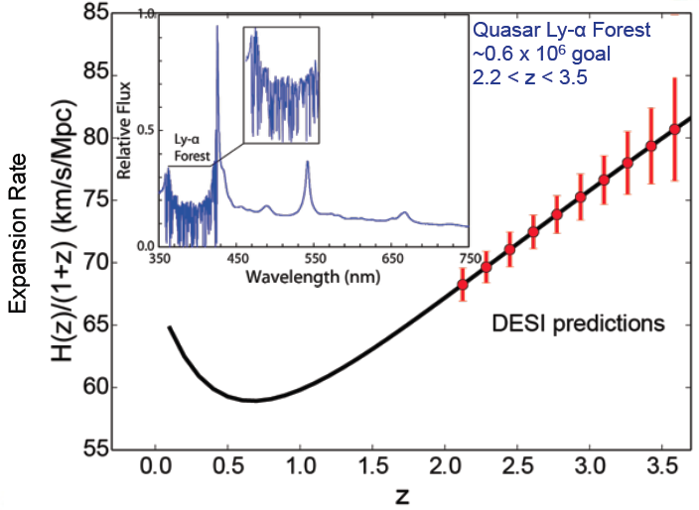
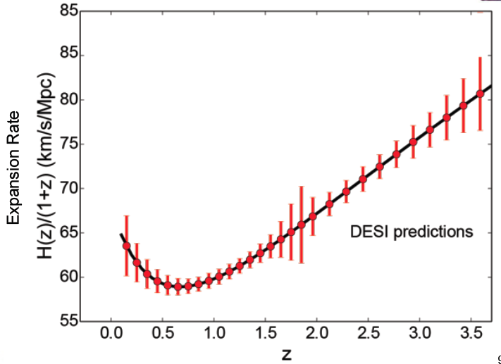
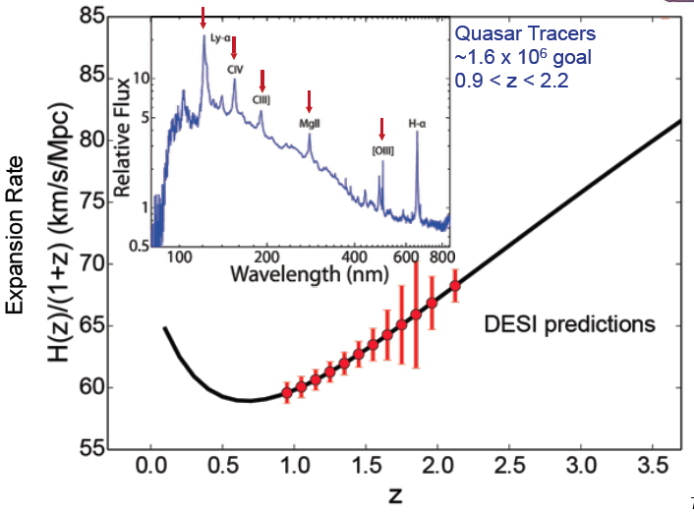
DESI on the Hubble Diagram

Slide 9
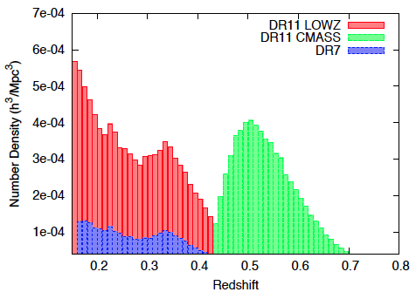
SDSS-III/BOSS DR11 results!
Results from Anderson et al. (2013): BAO results from CMASS and LOWZ, from both DR10 and DR11 samples.
Results from Chuang et al. (2013): Single-probe analysis of DR11 CMASS and LOWZ correlation function mutlipoles.
BOSS-CMASS DR11:
North: 556,896; South: 186,907
Total: 743,803 in 8,976 deg²

Slide 10
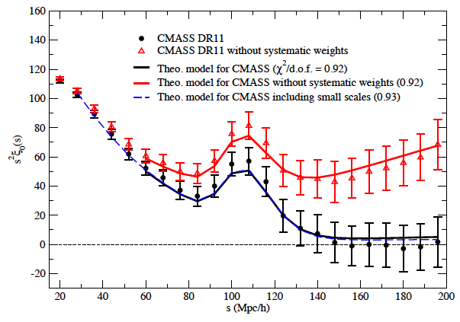

BOSS Galaxy Clustering results
The observed BAO position depends
simply on the scale dilation parameter
which measures the relative position of
the acoustic peak in the data versus the
model, thereby characterizing any
observed shift.
If α > 1, the acoustic peak is shifted
towards smaller scales, and α < 1 shifts
the observed peak to larger scales.
Measurement of effective monopole of the correlation function from the BOSS DR11 CMASS galaxy sample with/without systematics weights for star and seeing (black/red points), compared to the theoretical models given the parameters measured (solid lines). Chuang et al. (2013).

Slide 11
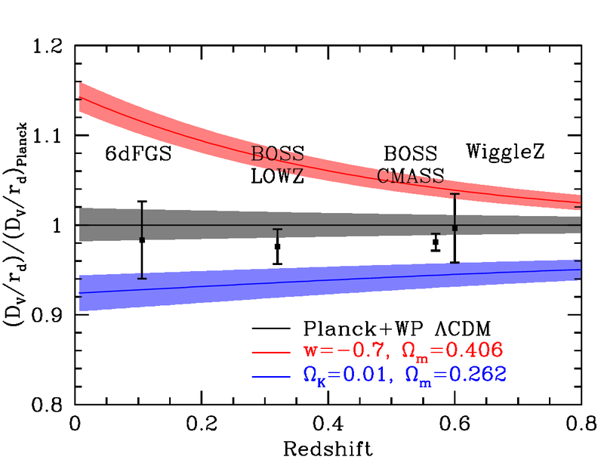
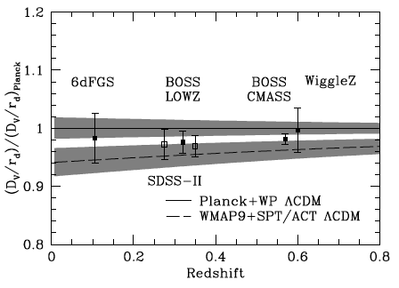
BOSS DR11 cosmology results
Anderson et al. (2013)
The distance-redshift relation from the BAO method on galaxy surveys. This plot shows DV (z)/r_{d} versus z measured from from galaxy surveys, divided by the best-fit flat LCDM prediction from the Planck data.

Slide 12
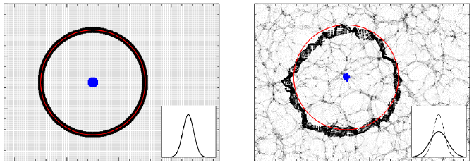
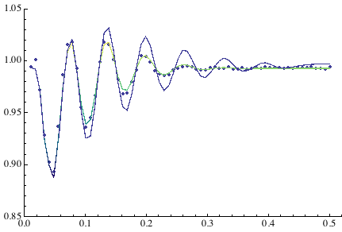
Physics of BAO
A pictorial explanation of how the BAO shifts and broadened since the early universe to the present day. In each panel, we show a thin slice of a simulated cosmological density field. (top left) In the early universe, the initial densities are very smooth. We mark the acoustic feature with a ring of 150 Mpc radius from the central points. A Gaussian with the same rms width as the radial distribution of the black points from the centroid of the blue points is shown in the inset. (top right) We evolve the particles to the present day, here by the Zel'dovich approximation. The red circle shows the initial radius of the ring, centered on the current centroid of the blue points. The large-scale velocity field has caused the black points to spread out; this causes the acoustic feature to be broader (Padmanabhan 2012).

Slide 13

Motivation
Modeling non-linearity and galaxy bias to use BAO, RSDs, weak-lensing and the power spectrum broad-band shape at the 0.1-1% level.
Using Halo Abundance Matching for accurate modeling of galaxy bias
Providing clustering and bias model useful
to compare with perturbation theory predictions
to facilitate the massive production of mock
galaxy catalogs (PATCHY + BigMultiDark).
In particular, studying BAO systematics:
shift and damping for biased tracers.

Slide 14
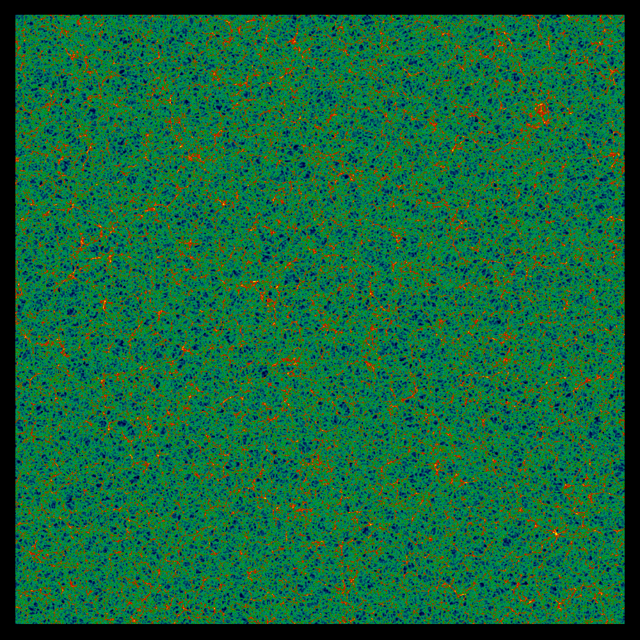


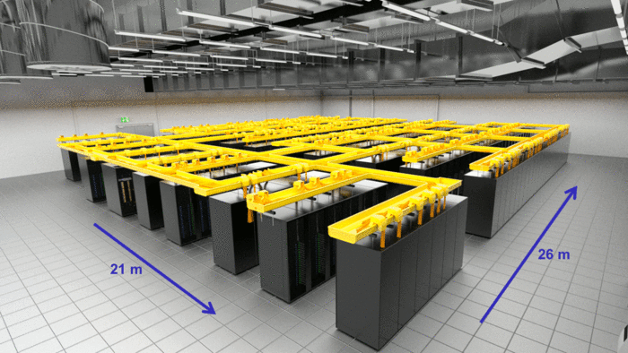

www.multidark.org
Europe's fastest supercomputer
SuperMUC Petascale System
2.5 Gpc/h
New BigMD Runs:
L_{box}= 2500 h⁻¹ Mpc; N_{part}= 3840³
Force res.= 10 kpc/h comoving; M_{part}=2.08 10¹⁰ h⁻¹ M_{sun}
4.7 10¹⁵ h⁻¹M_{sun}

Slide 15
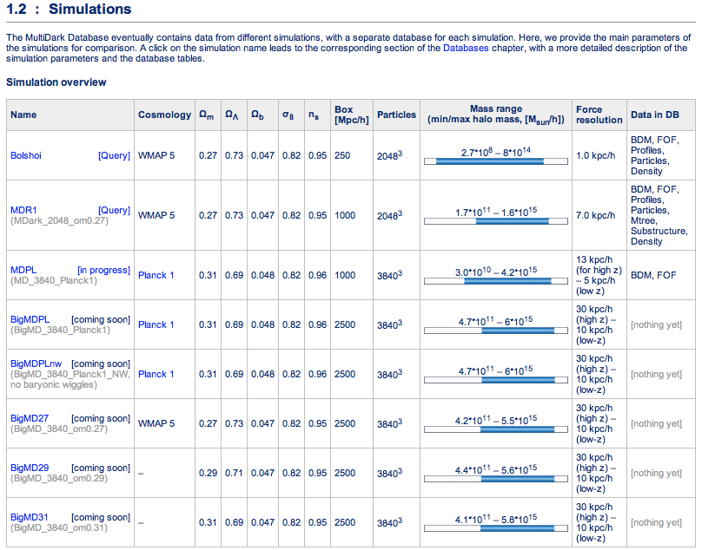

The New Suite of MultiDark Simulations for Large Surveys
>> The BigMD Project <<
z=0.57
14M halos
First BOSS light-cone!
www.multidark.org

Slide 16
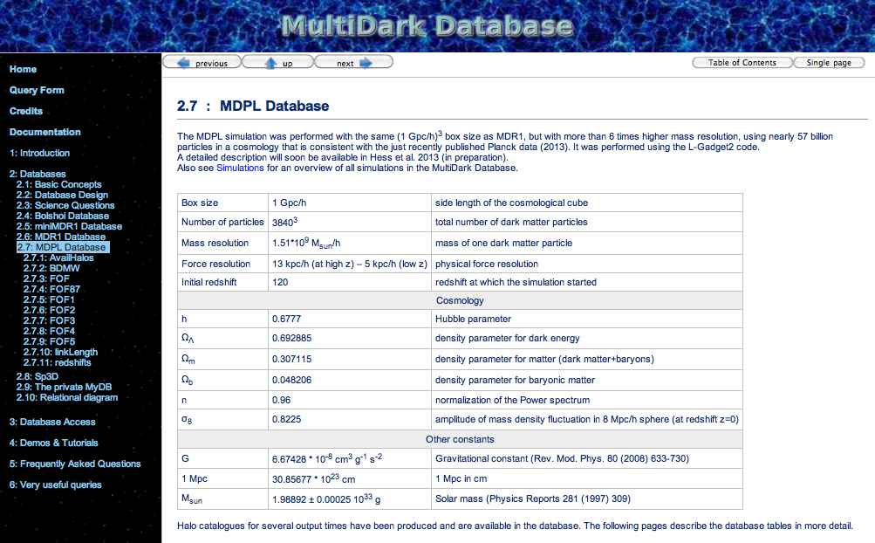

Slide 17
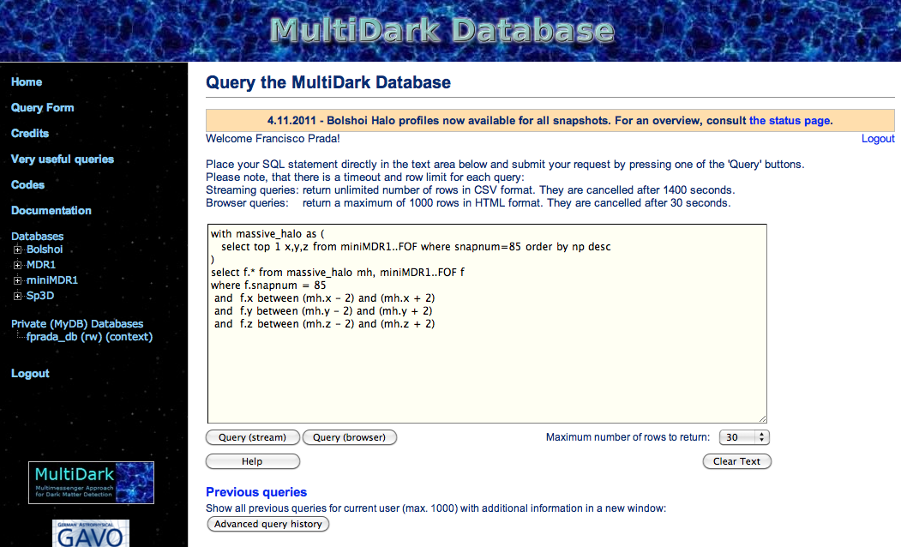
www.multidark.org

Slide 18
>> The BigMD Project <<
www.multidark.org
/BigMDPlanck1
Simulation and Cosmological parameters of our MultiDark boxes in comparison with other large simulations run by different groups. The size of the circles shown in the left panel corresponds to the inverse of the force resolution adopted for each simulation. The contour levels in the right panel correspond to the 68% and 95% CL from Planck.

Slide 19
Zeldovich vs. 2LPT Initial Conditions

Slide 20
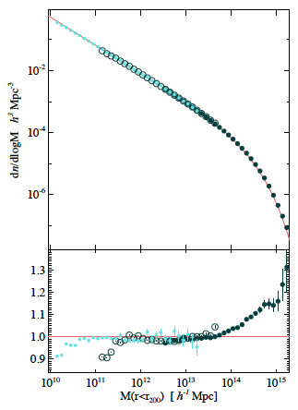
Halo Mass Function in the Planck Cosmology
Differential mass function of spherical overdensities. As reference the Tinker et al. mass function for of Planck cosmology is shown as red line. Dividing the simulated mass functions by Tinker (bottom panel) reveals an excess of high mass halos. Hess et al. (2014), in prep

Slide 21
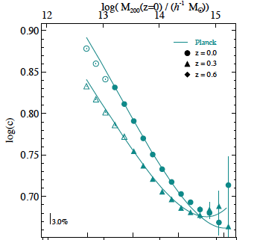
Halo Mass-Concentration Relation in the Planck Cosmology
Hess et al. (2014), in prep

Slide 22
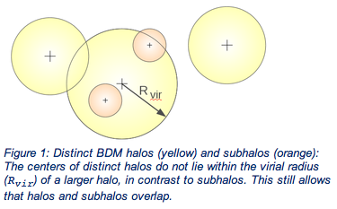
Subhalos
Dark Matter Halos in the MultiDark simulations
Distinct Halos

Slide 23
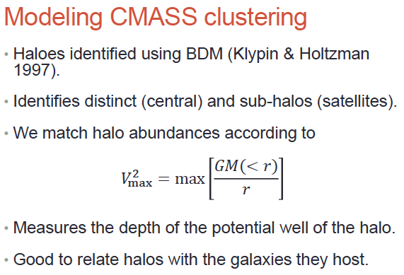

Slide 24
Velocity functions for Subhalos and Distinct Halos
MultiDark @ z=0
Evolution
V²_{max}=max[GM(<r)/r] is the maximum of the halo circular velocity profile

Slide 25
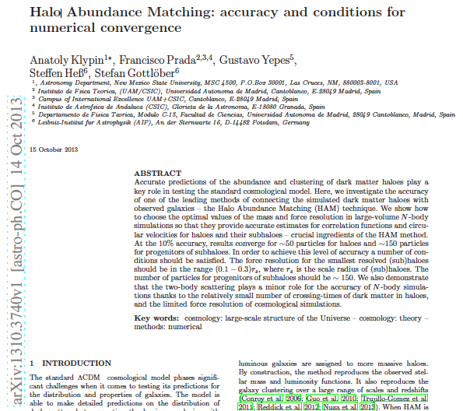

Slide 26
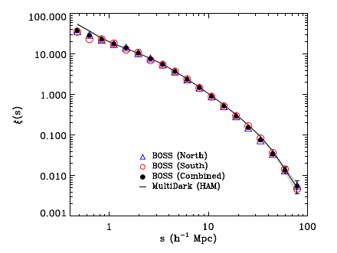
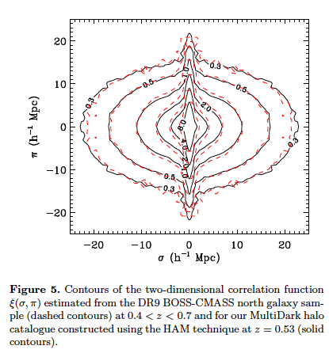
The clustering of galaxies at z=0.5 in the SDSS-III Data Release 9 BOSS-CMASS sample: a test for the CDM cosmology
Nuza et al. 2013

Slide 27
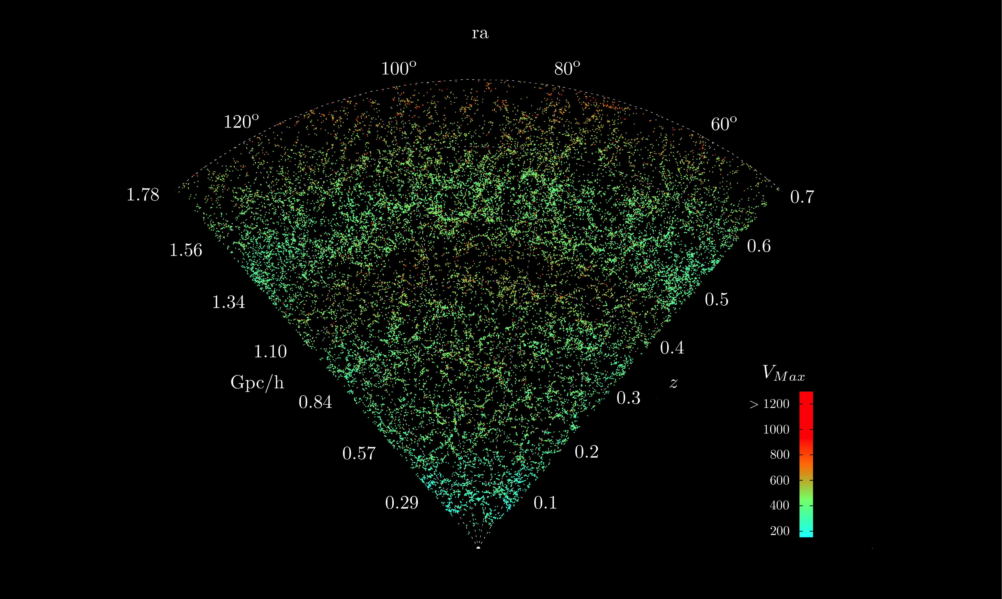
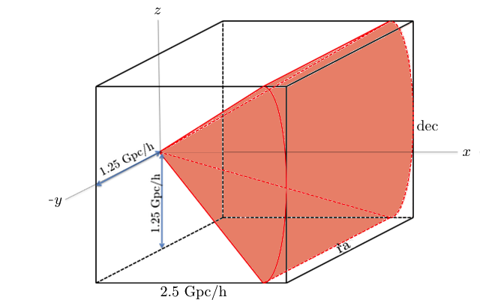
>> The BigMD Project <<
z=0.57
14M halos
Products:
Row particle data
FOF & BDM halo catalogs
(sub)Halo profiles
Merging Trees
BOSS galaxy light-cones
- “Add to Wish List”
www.multidark.org

Slide 28
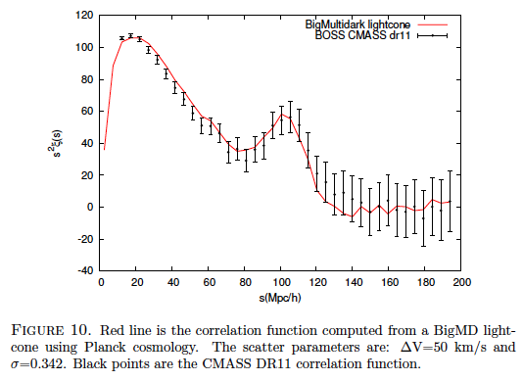
The clustering of galaxies at z=0.5 in the BOSS-CMASS DR11
Rodríguez et al. 2014, in prep.

Slide 29
Large-scale Galaxy Clustering and Bias
BAO systematics study
BOSS-CMASS galaxy power spectrum compared to
BigMD-SHAM prediction for n=3e-4 at z=0.57
(courtesy of Francesco Montesano)

Slide 30
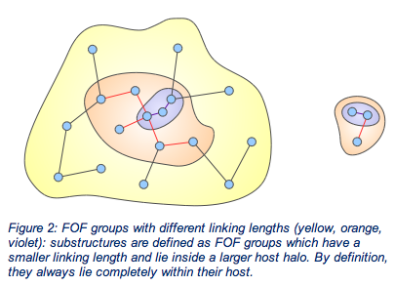
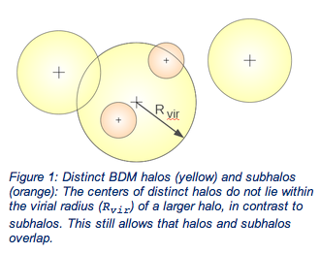
SO vs. FOF halo clustering
ll=0.02
ll=0.2
ALL
Distinct
The power spectrum and bias of BDM and FOF (sub)halos with
Number den3.5 10⁻⁴ taken from the BigMultiDark Planck1 box

Slide 31
The effect of small-scale clustering on the large-scale tail of the power spectrum
The power spectrum and bias of SO and FOF (sub)halos with
3.5 10⁻⁴ number density taken from BigMultiDark Planck1 box

Slide 32
The effect of small-scale clustering on the large-scale tail of the power spectrum
After all, why clustering at large scales should be affected by inclusion of subhalos at much smaller scales? However, there are two effects:
The first one, is rather simple. There are more subhalos of given mass (or circular velocity) in each massive distinct halo as compared with less massive halo. When subhalos are included, larger halos give proportionally larger contribution to the estimate of the power spectrum. Because larger halos are more biased, the power spectrum and the correlation function are larger on all scales. In practice, this effect results in almost scale-independent bias.
The second effect is more subtle. There is a change – a boost due to subhalos – in the power spectrum even when there is no change in the large-scale correlation function. This happens because the power spectrum and the correlation function are connected through an integral relation. This effect results in a scale-dependent bias and its effect gets progressively small for small wavenumbers k.

Slide 33
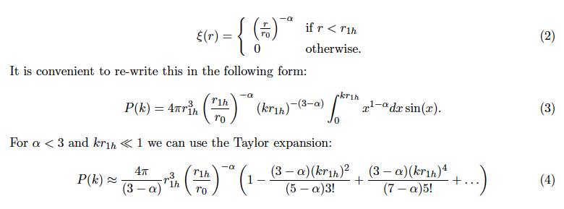
The effect of small-scale clustering on the large-scale tail of the power spectrum
We can compare our theory estimates with the results for the observed power spectrum of BOSS CMASS sample. For BAO oscillations at k < 0.2 h Mpc⁻¹ the effect of subhalos is quite small, but potentially measurable. For example, at k = 0.2 h Mpc⁻¹, we have estimated P=370 h⁻³ Mpc³ from the 1-halo term of the correlation function. Measured power is P ≈ 5000 h⁻³ Mpc³. Thus, subhalos contribute about 10% to the clustering signal. Yet, this change both the amplitude and the shape of the spectrum, and, thus, they substantially affect the shape and the value of the bias.

Slide 34
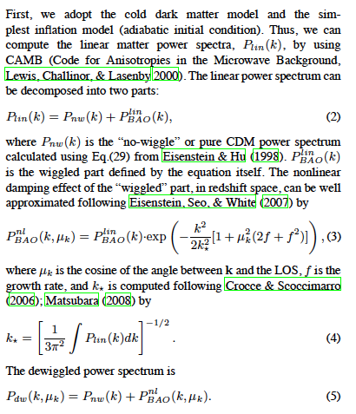
Modeling halo clustering and bias
₂
ALL
Distinct
Scale-dependent bias
b²(k)=P(k)/P_{lin}(k)
Large-scale halo power spectrum model:
P(k) =

Slide 35
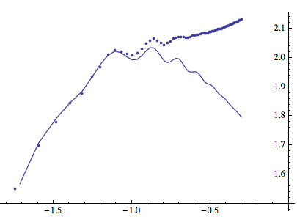
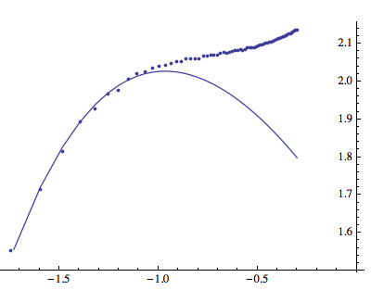
Accurate measurement of the BAO shift and damping
P(k) BigMD Planck1
P(k)/P_{nw}(k) BigMD Planck1
P(K) Planck1_NW

Slide 36
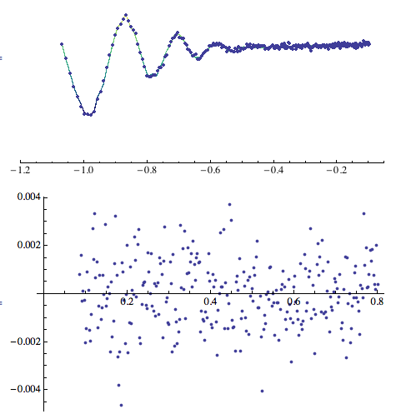
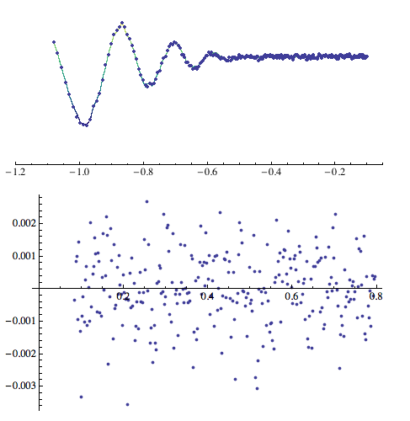

P(k)/P_{nw}(k) for DM & Halos in BigMD Planck
DM (z=0.57)
Chi2/dof=1.12
Halos n=2.5e-3 (z=0.57)
Chi2/dof=1.11
Very accurate measurement of BAO shift & damping

Slide 37
BAO shift & k* damping in the Planck Cosmology
DM
Halos n=1.0 e-3
Halos n=3.0 e-4

Slide 38
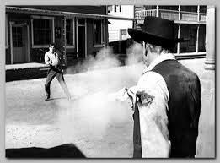
BAO shift as a function of bias

Slide 39
BAO damping as a function of bias

Slide 40
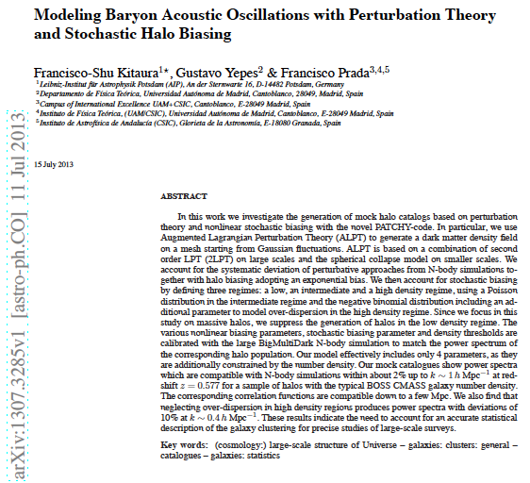

Slide 41
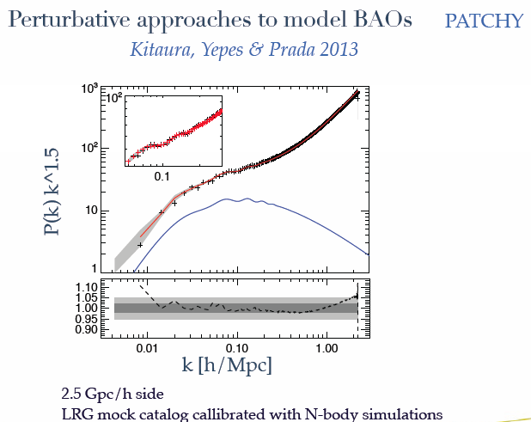
PATCHY vs. BigMultiDark

Slide 42
Conclusions
The new suite of BigMD simulations is being uploaded in the MultiDark Database: www.multidark.org
BigMD is designed to study LSS and BAO systematics
Clustering at large-scales should be affected by inclusion of subhalos at much smaller scales. This change both the amplitude and the shape of the spectrum, and, thus, they substantially affect the shape and the value of the bias.
Scale-dependent bias at BAO scales k<0.4 can be modeled by simple function, i.e. b(k)=b₀ (1+log₁₀[1+b₂ k^{2.15}]
BAO shift & damping scale k*, and its evolution, has been studied both for dark matter and different halo number densities and compared to perturbation theory predictions
It remains to be understood the impact of this study on the BAO modeling and reconstruction

