Slide 1
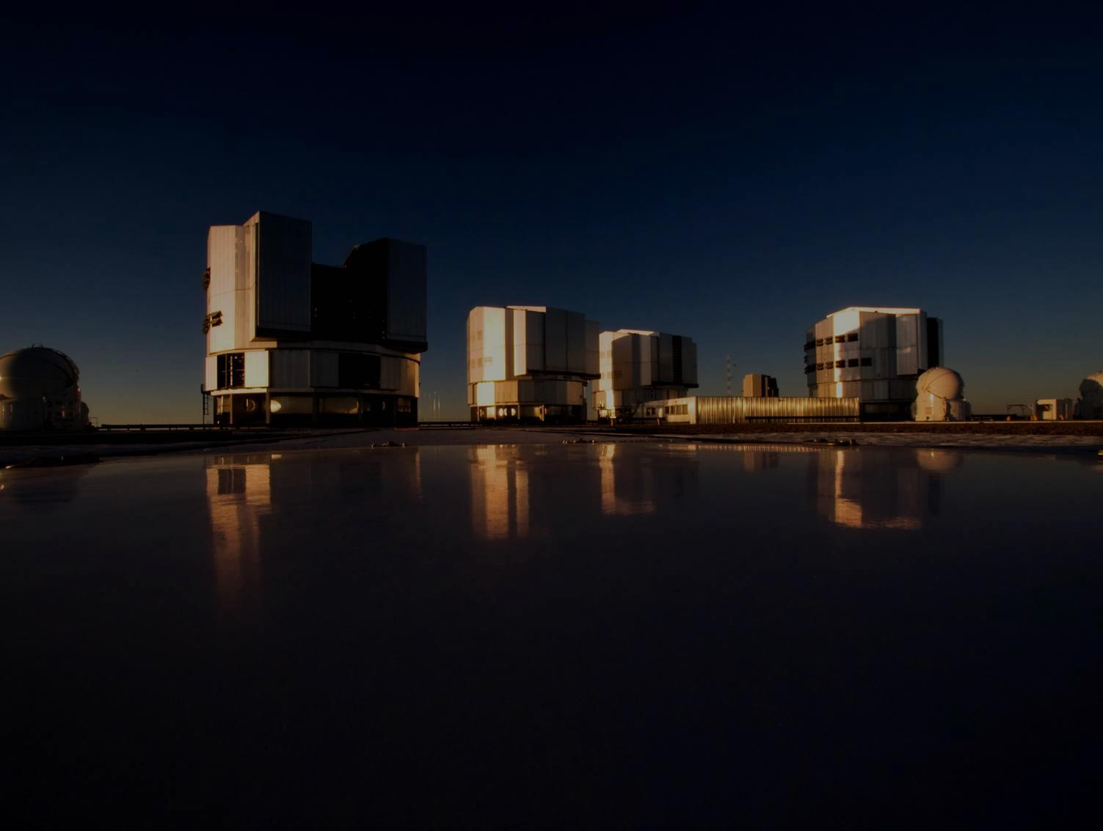
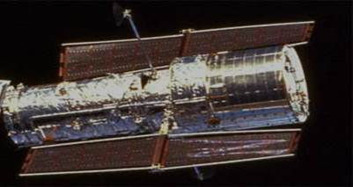
Recent Results on Star Forming Disk Galaxies
at the Peak Epoch of
Cosmic Galaxy Formation: KMOS^{3D}
R.G., N.M. Förster Schreiber, Linda Tacconi and the KMOS^{3D}, SINS/zC-SINF, 3D-HST, PHIBSS/2 Teams
E. Wisnioski , E. Wuyts, S. Wuyts, P. Lang, D. Lutz, M. Fossati, D. Wilman, A. Renzini, S. Tacchella, M. Carollo
K. Bandara, A. Beifiori, R. Bender, N. Bouché, G. Brammer, A. Burkert, J. Chan, A. Cimatti, G. Cresci, E. Daddi, R. Davies, D. Erb,
A. Galametz, S. Kulkarni, S. Lilly, C. Mancini, J.T. Mendel, I. Momcheva, T. Naab, E.J. Nelson, S. Newman, Y. Peng, D. Rosario,
R. Saglia, S. Seitz, A. Shapley, C. Steidel, A. Sternberg, E. Strobl-Hicks, K. Tadaki, H. Übler, P. van Dokkum, D. Vergani, G. Zamorani

Slide 2
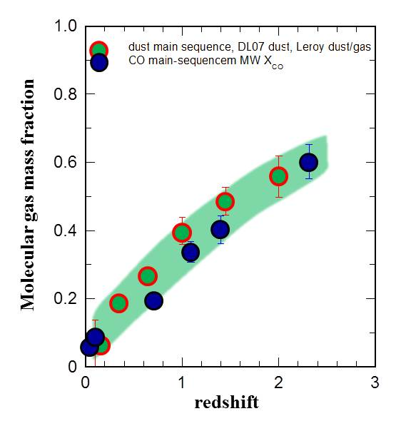
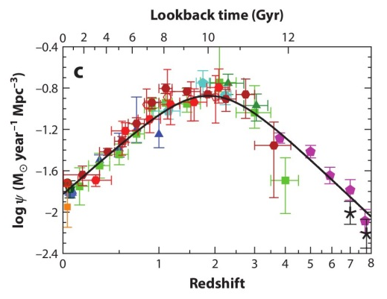
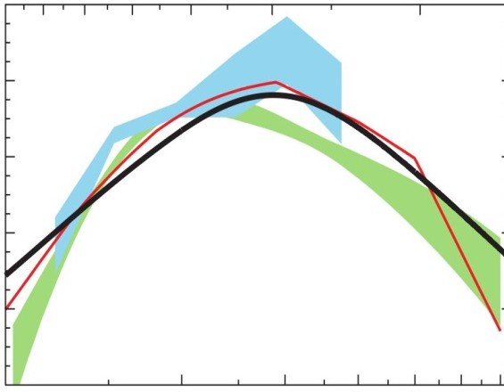
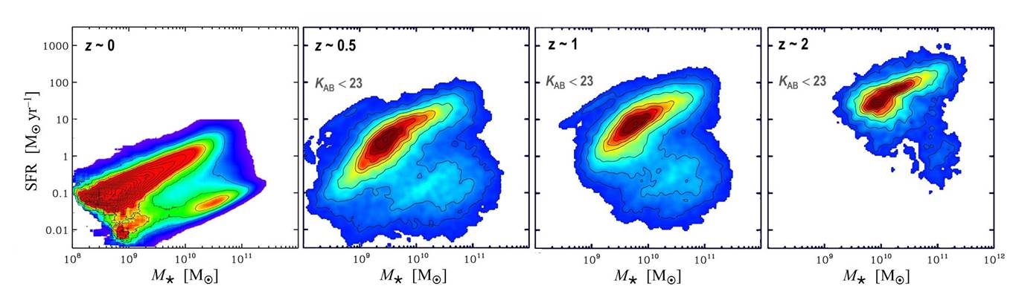

Star formation at the peak of the galaxy formation epoch
 SFR ∼ M on the MS
 ~ 90% of the cosmic SFR occurs on the MS
 MS SFGs have gas depletion times $≲$ 1 Gyr
 Efficient quenching above log(M/M ) ~ 11
SFR
BH accretion
(scaled)
×20
Renzini & Peng 2015
Tacconi+13;Genzel+15
Madau & Dickinson14
Madau +96, Lilly +96, Steidel +96, Hopkins & Beacom 2006, Rudnick+03,06; Noeske+07; Elbaz+07; Daddi+07,10; Marchesini+09; Shankar+09; Ilbert+10,13; Peng+10; Brammer+11;
Rodighiero+11,14; Caputi+11; Gonzalez+11; Magnelli+11,12,13; Saintonge+11,13; Whitaker+12,14; Combes+12; Magdis+12;
Ilbert+13; Muzzin+13; Stark+13; Steinhardt+14; Koprowski+14,15; Tasca+15; Grazian+15; Renzini&Peng15

Slide 3
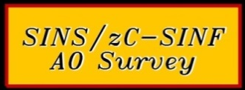
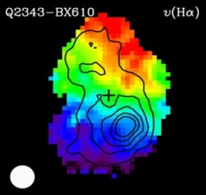
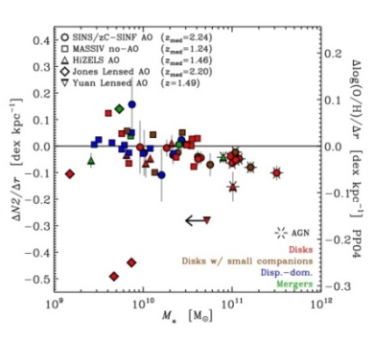
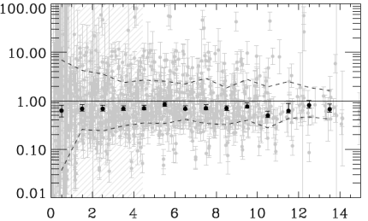
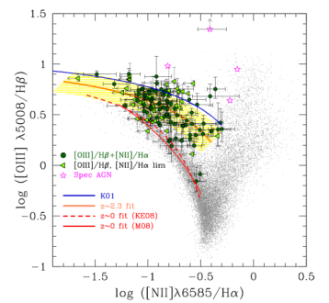
In Situ Studies of the high-z MS-Galaxy Population
KMOS-3D
PEP@ Herschel
COLDGASS & PHIBSS
CANDELS- 3D HST
ATLAS
IMAGES
MASSIV
AMAZE-
LSD
HiZELS
MOSDEF
SPT
KROSS
ALESS
KBSS
WigglezZ
angular
momentum
rotation
kinematics: rotation vs. dispersion, perturbations
mass budgets & angular momentum
gas – star formation scaling relations & cosmic evolution, ISM properties
dependence of SF on structure, environment
outflow & quenching processes
scaling relations with metallicity, excitation
AGN – star formation co-evolution
turbulence
metallicity gradients
z
baryon fraction
radius (kpc)
gas fractions
quenching
ISM excitation
molecular gas fraction
feedback
HI
redshift
Burkert et al. 2015, Wuyts et al. 2014, 2016, Sobral et al. 2014, Foerster Schreiber et al. 2014, 2015 Genzel et al. 2014a,b , 2015, Steidel et al. 2014, Wisnioski et al. 2012, 2015, Tacconi et al. 2013, Barro et al. 2012, 2015, Lang et al. 2014, Steidel et al. 2014, Sanders et al. 2014, Coil et al. 2014, Kriek et al. 2015, Price et al. 2015, Nelson et al. 2015, van Dokkum et al. 2015, Stott et al. 2016, Magdis et al. 2016, Schreiber et al. 2016

Slide 4
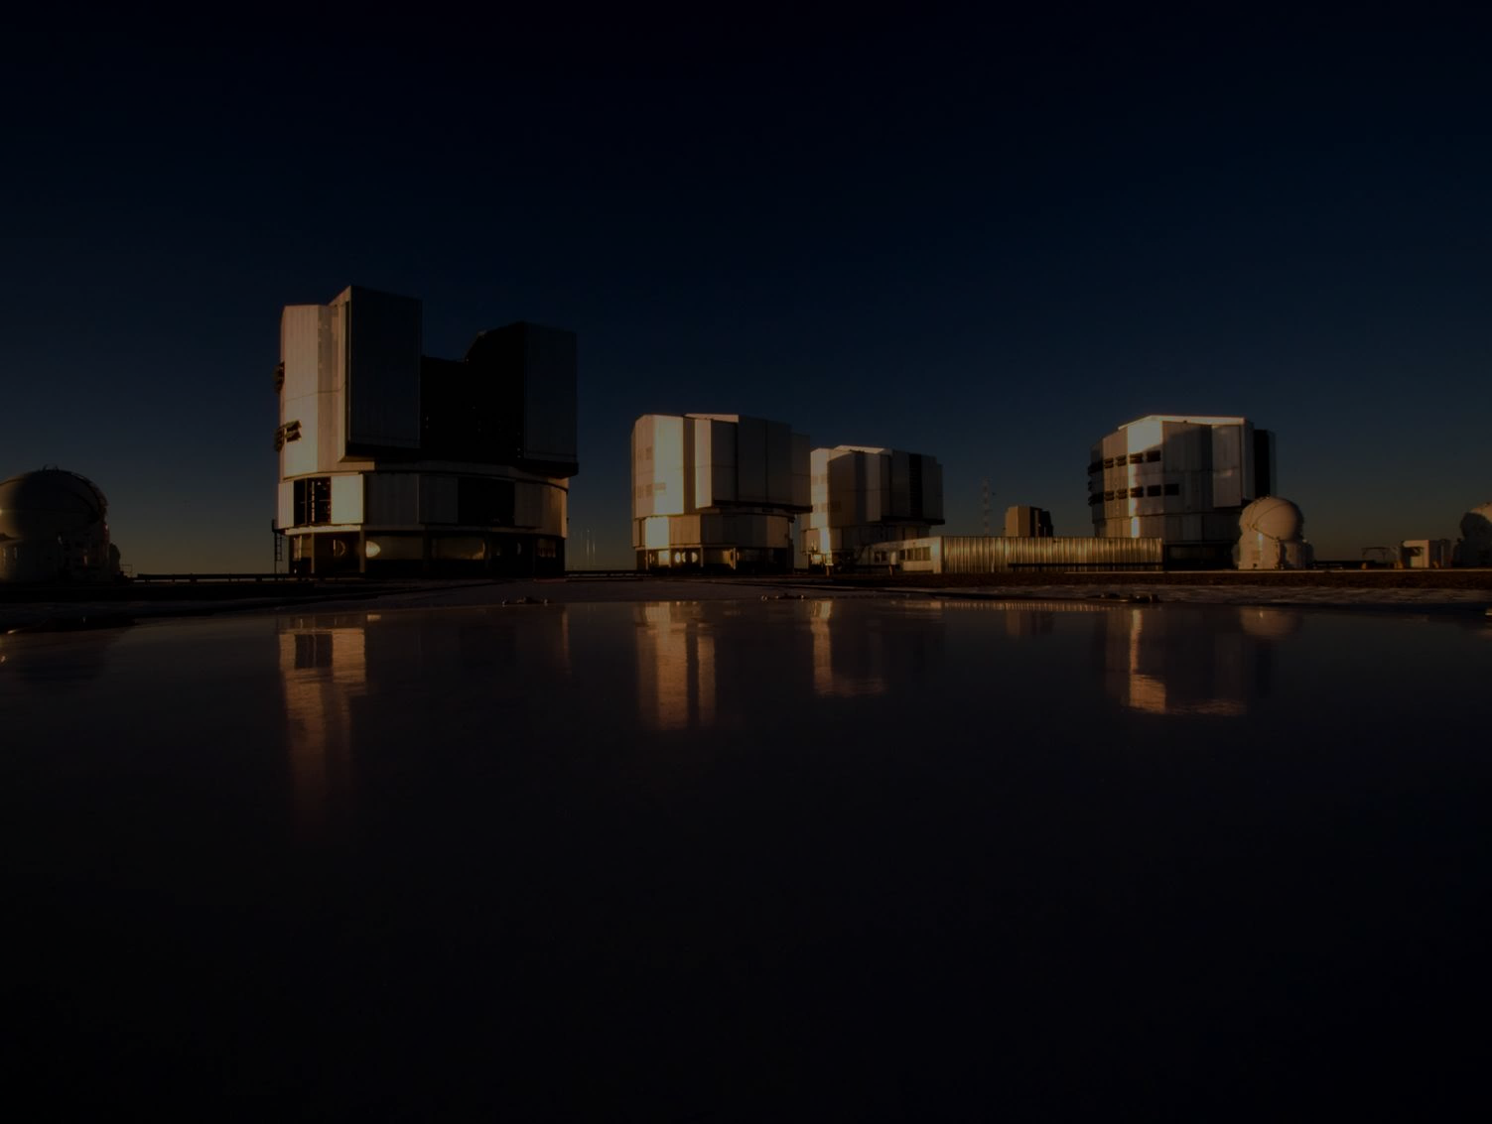
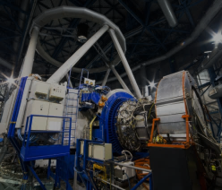
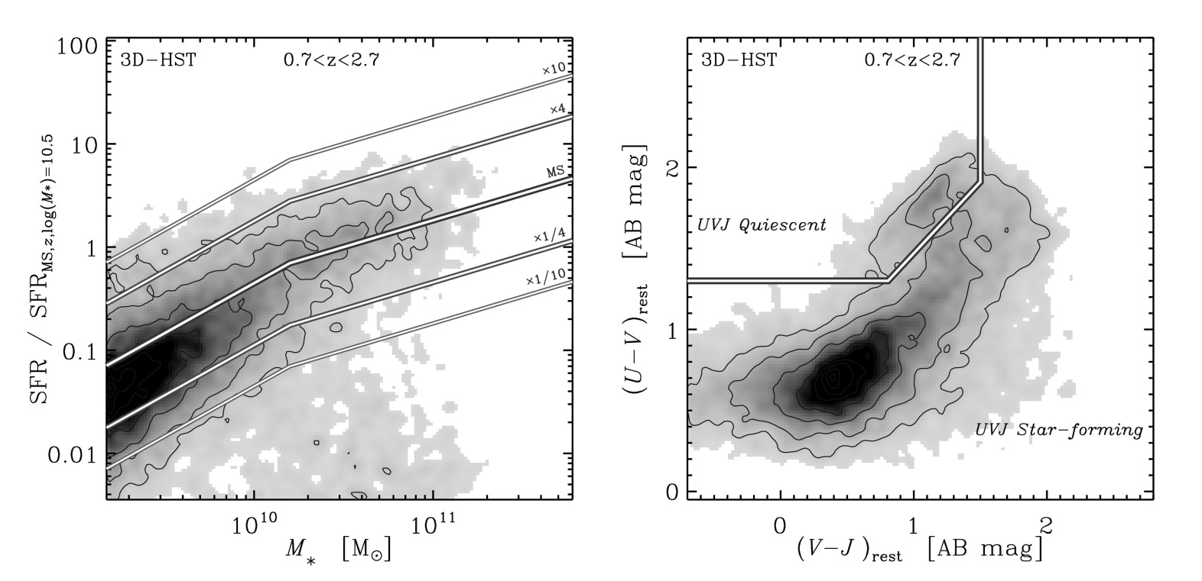
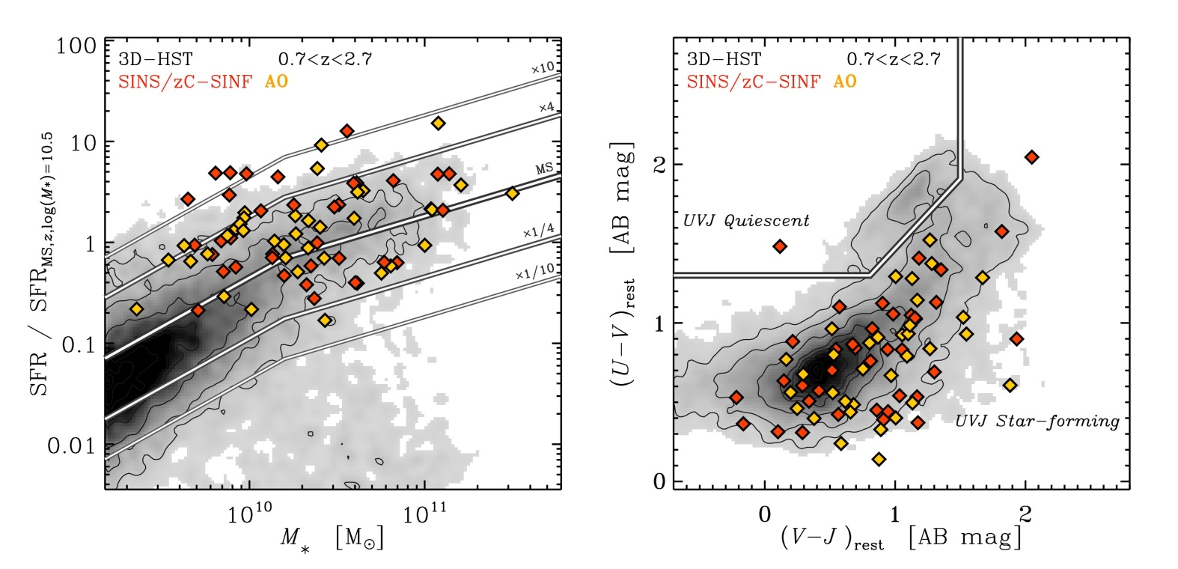
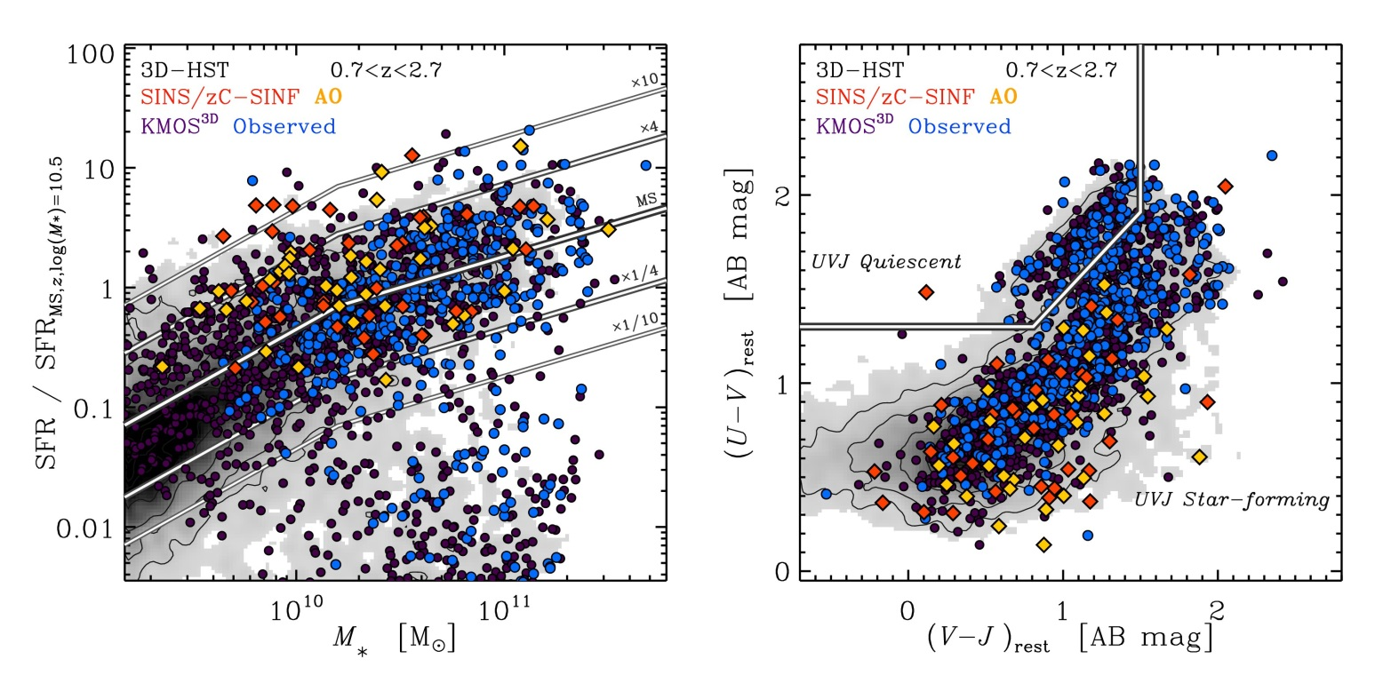
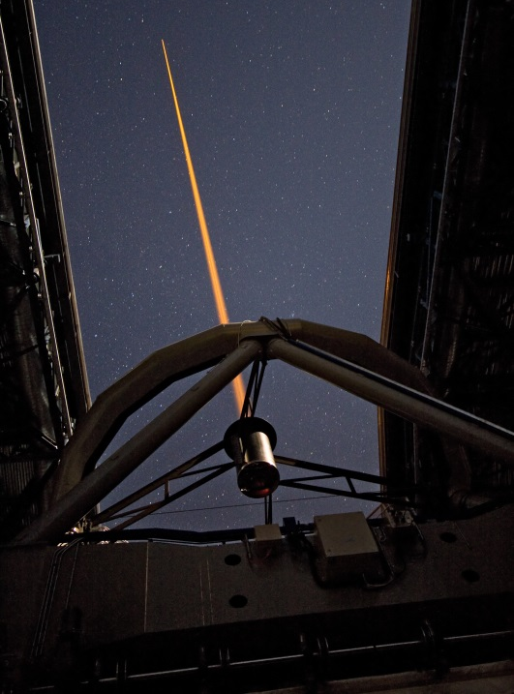
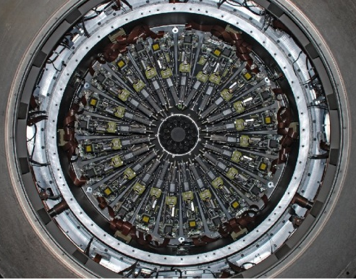
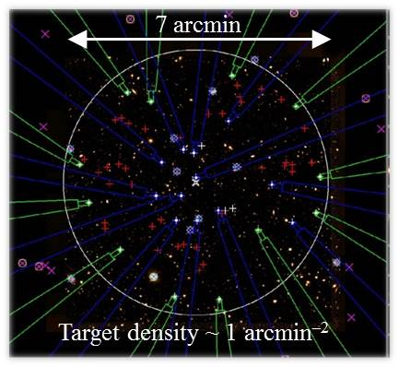
KMOS-3D
CANDELS
3D-HST
SINS/zC-SINF & KMOS^{3D}
MPE IFU surveys of massive SFGs at z ~ 1 – 3
Deep integrations (~3–20+ hr) – Hα+[NII]+[SII]
KMOS^{3D}
SINS/zC-SINF
• 600-700 M -selected z~0.7-2.7 SFGs, 5 year, 85 night GTO (536 Jan 1 2016)
• 110 SFGs at z ~ 1–3
• 3D-HST/CANDELS fields
• 35 at z ~ 2 with AO
• wide coverage in M–SFR–UVJ
• HST NIR/optical imaging
KMOS
24 IFUs
Sharples et al.
2012, 2013
Wisnioski et al.
2015
SINFONI & AO

Slide 5
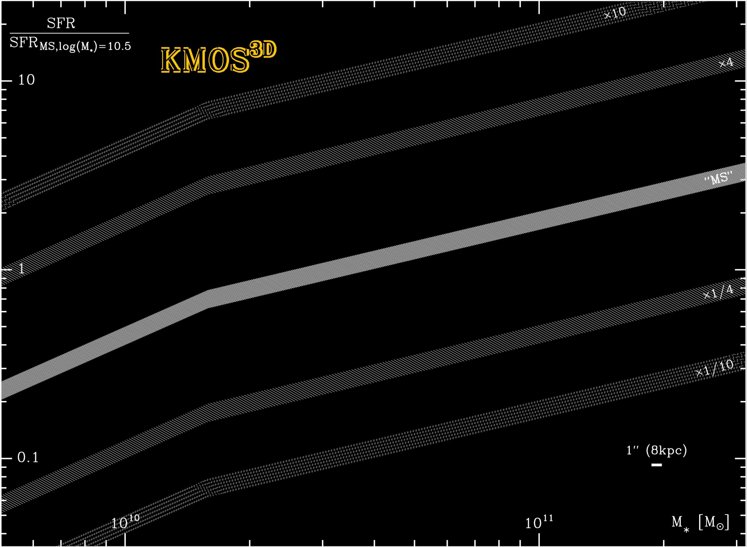
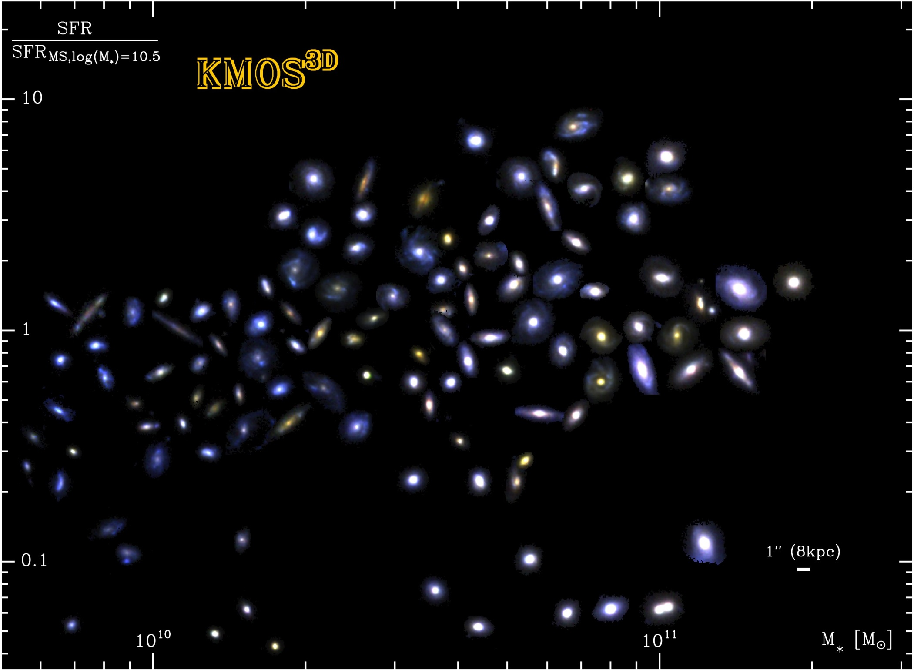
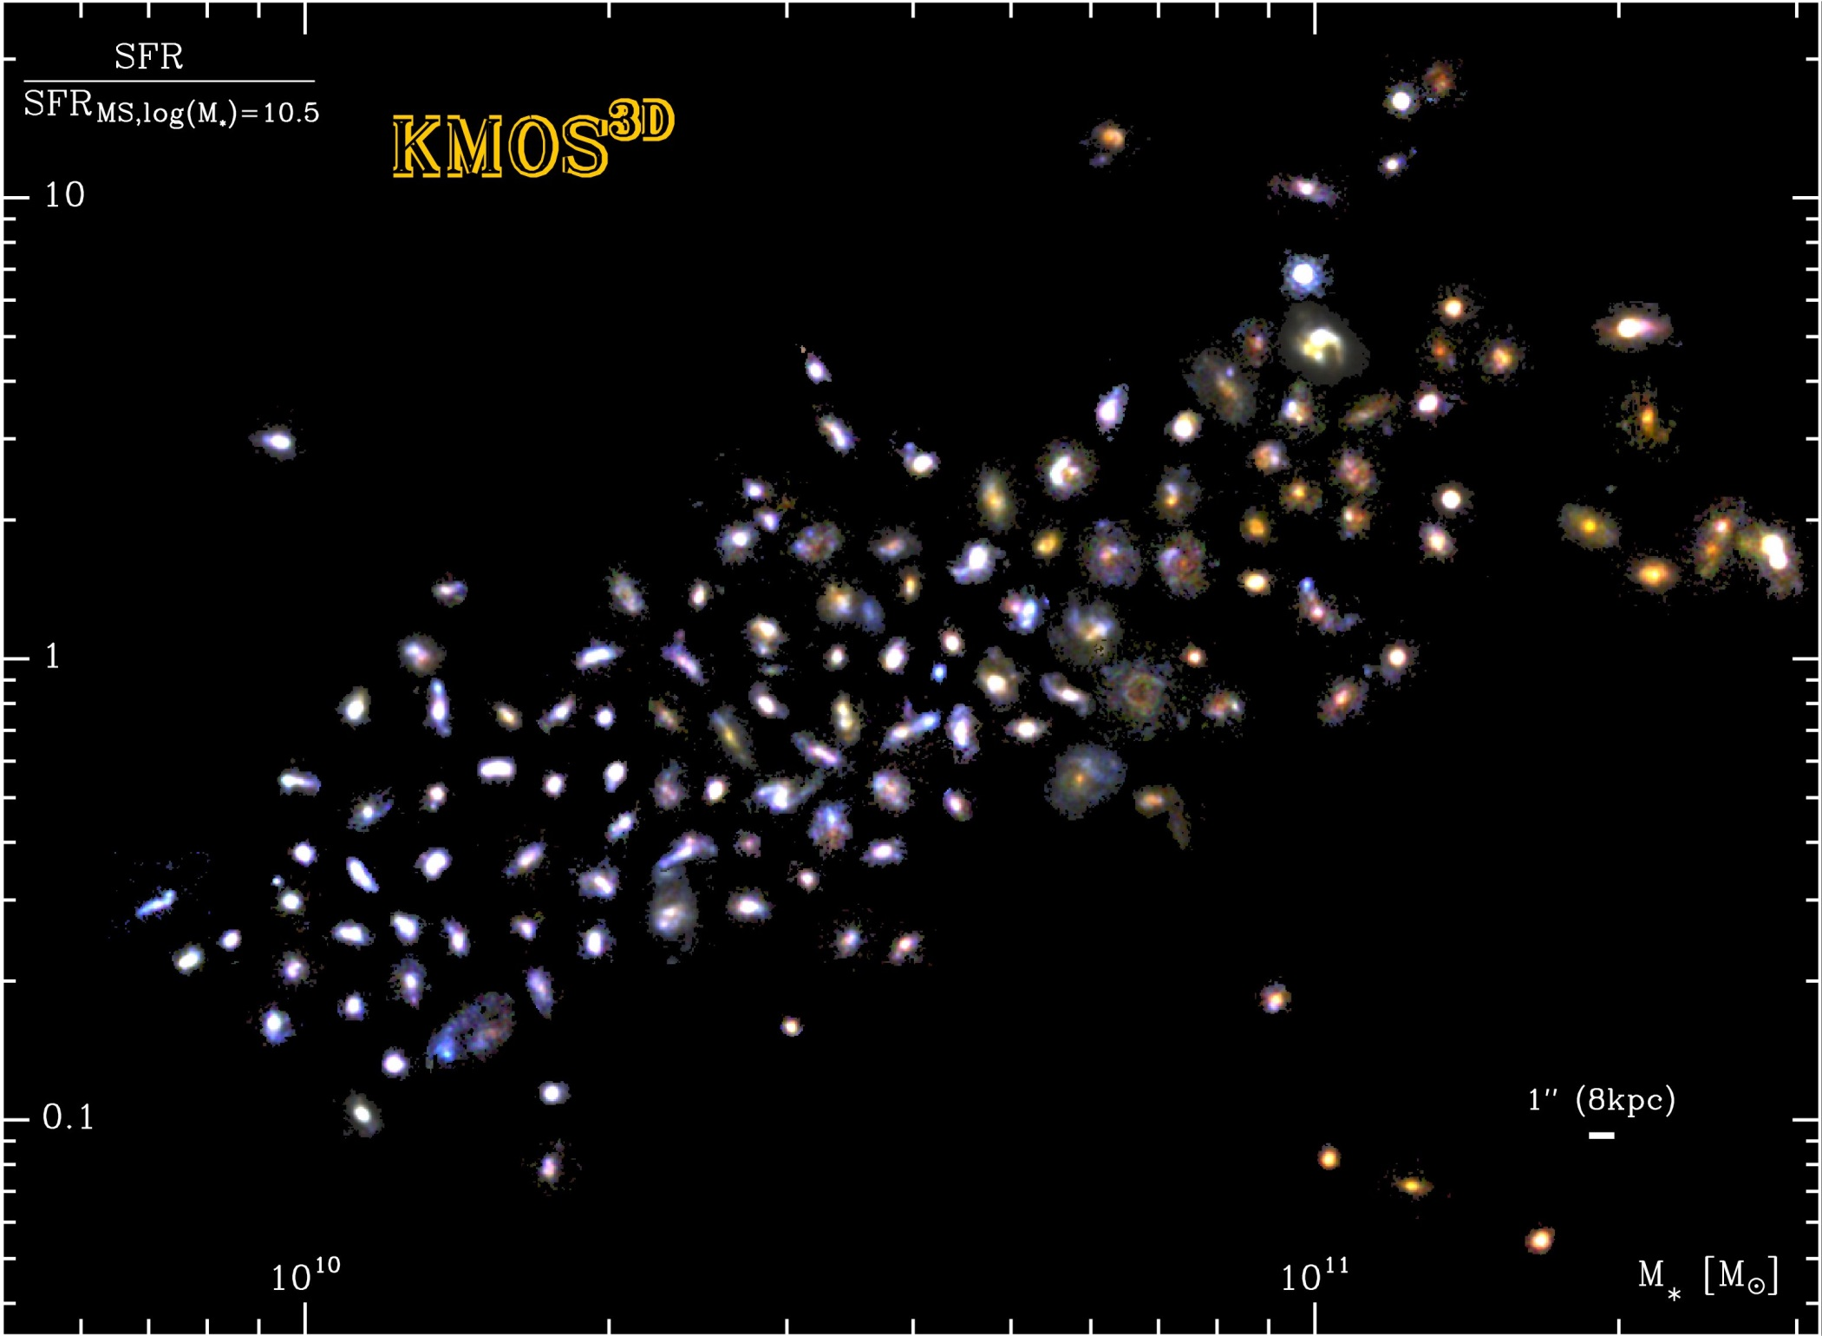
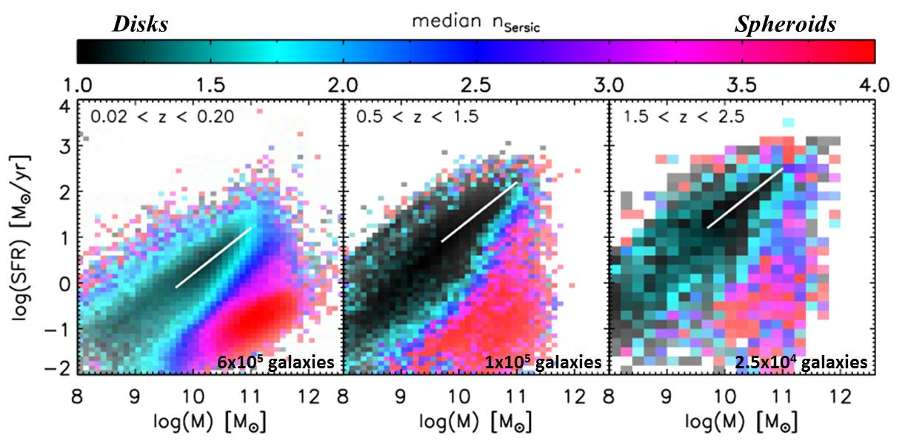
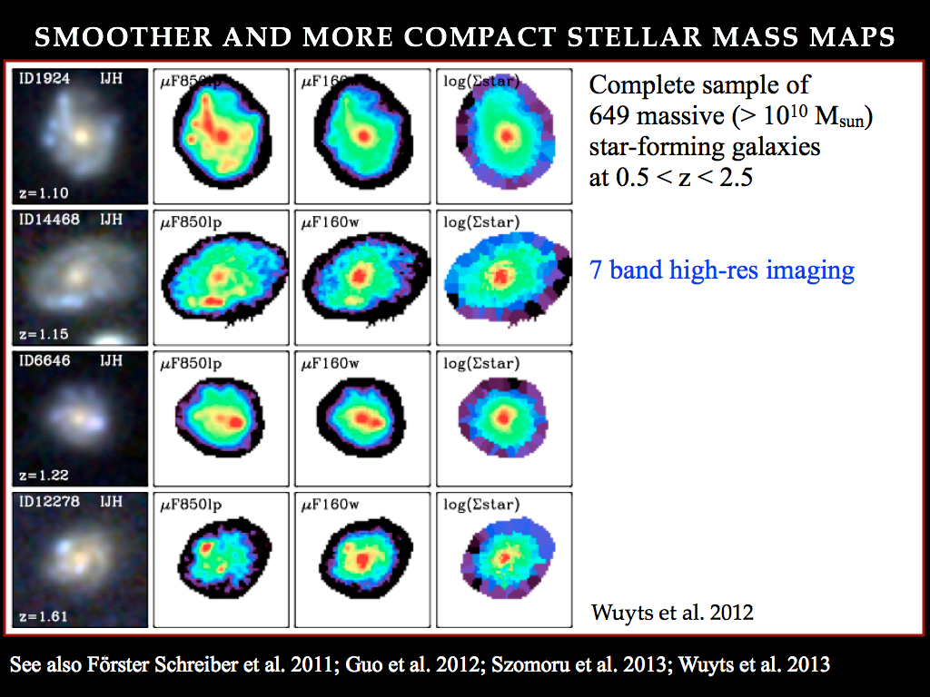
KMOS-3D
Morphologies of z ~ 1 – 3 SFGs
A majority of disks
w/ clumpy SF
IJH HST/CANDELS
Clumpy SFGs:
2800Å N~75%, L~10-25%
V_{rest} N~30-40%, L~10-15%
Rest-UV
Rest-optical
Stellar mass
Wuyts+12,13
Wuyts+11
KMOS^{3D} – Wisnioski+15
E.g., Labbé+03;Lotz+06,08,10; Elmegreen+07-09;Kriek+09;NMFS+11a,b;Guo+12,15;Szomoru+13;Nelson+13;Tacchella+15a,b;Tadaki+14a;Cibinel+15

Slide 6
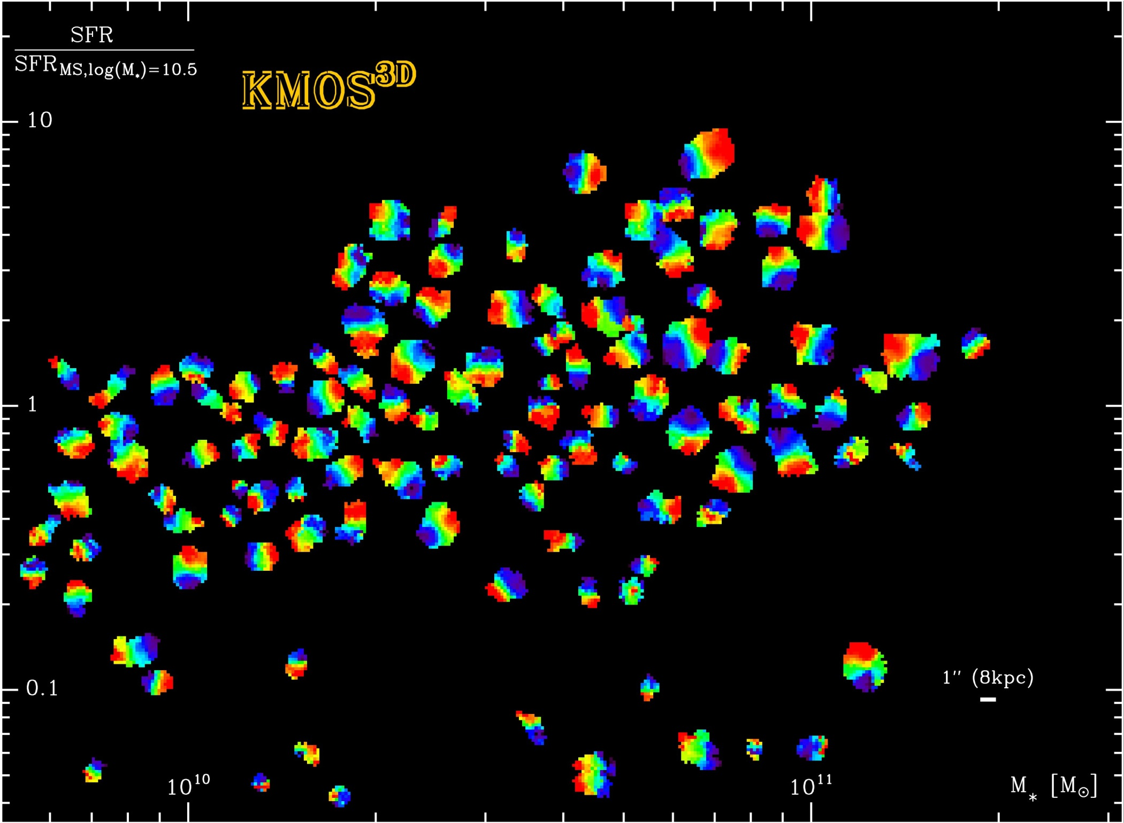
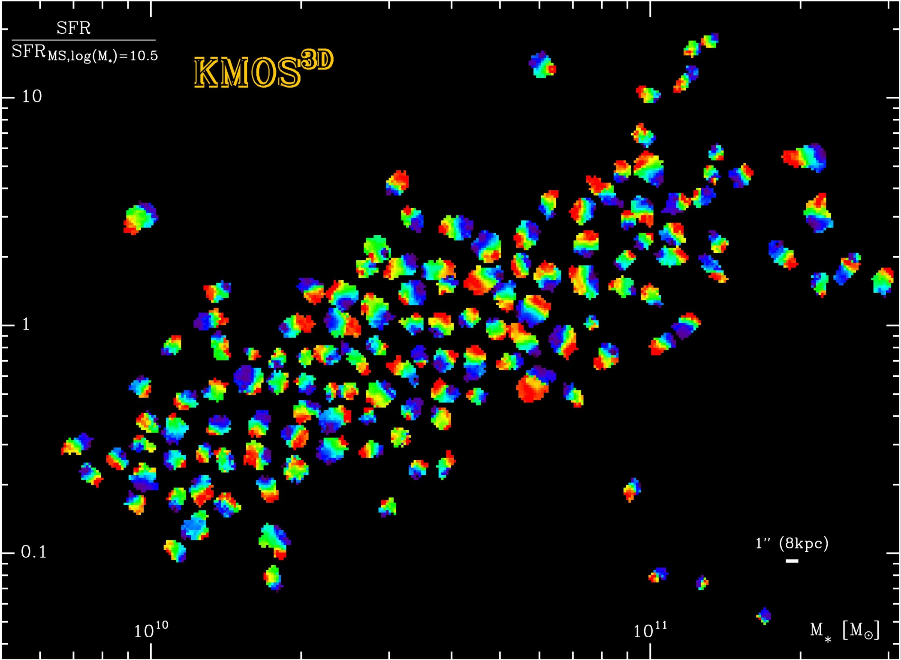

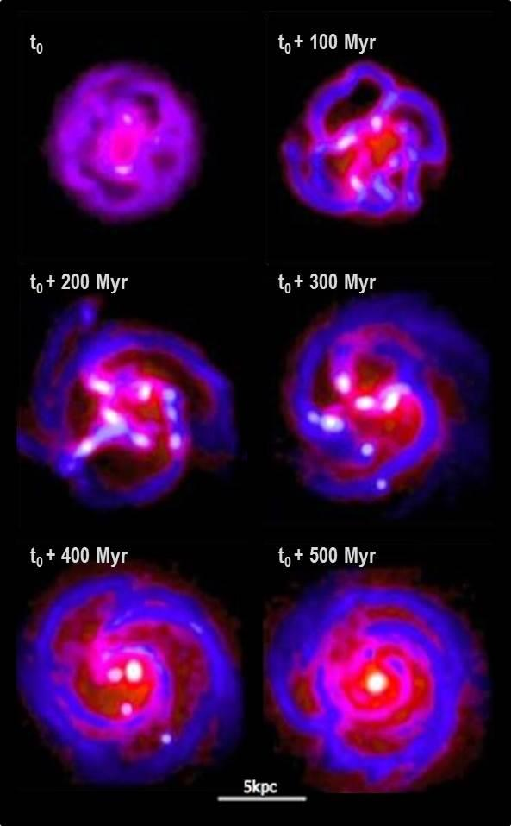
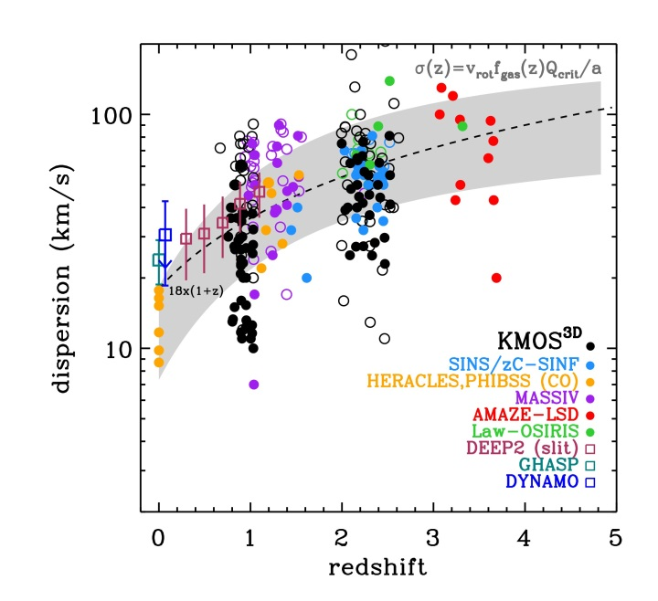

KMOS-3D
Kinematics of z ~ 1 – 3 SFGs
A majority of high-z SFGs are rotationally
supported, turbulent disks
Hα VFs VLT/KMOS^{3D}
Q~1 disks:
$\frac{Vrot}{σ0}\sim \frac{Rdisk}{hz}\sim \frac{1}{fgas}$
Bournaud et al.+07–15
And, e.g., Noguchi+99; Immeli+04; Carollo+07;
Agertz+09; Dekel+09,13; Ceverino+10,12;
Genel+12; Hopkins+12; Mandelker+14;
Dekel&Burkert14; Zolotov+15; Tacchella+15c
Wisnioski+15; Genzel+06,08,11; NMFS+06,09,15; Shapiro+08; Cresci+09; Tacconi+13; Newman+13
Also, e.g., Law+09,12;Epinat+09-12;Jones+10;Green+10; Wisnioski+11,12; Yuan+11,12;Kassin+12; Sobral+13;Stott+14; Livermore+15; Leethochawalit+15

Slide 7
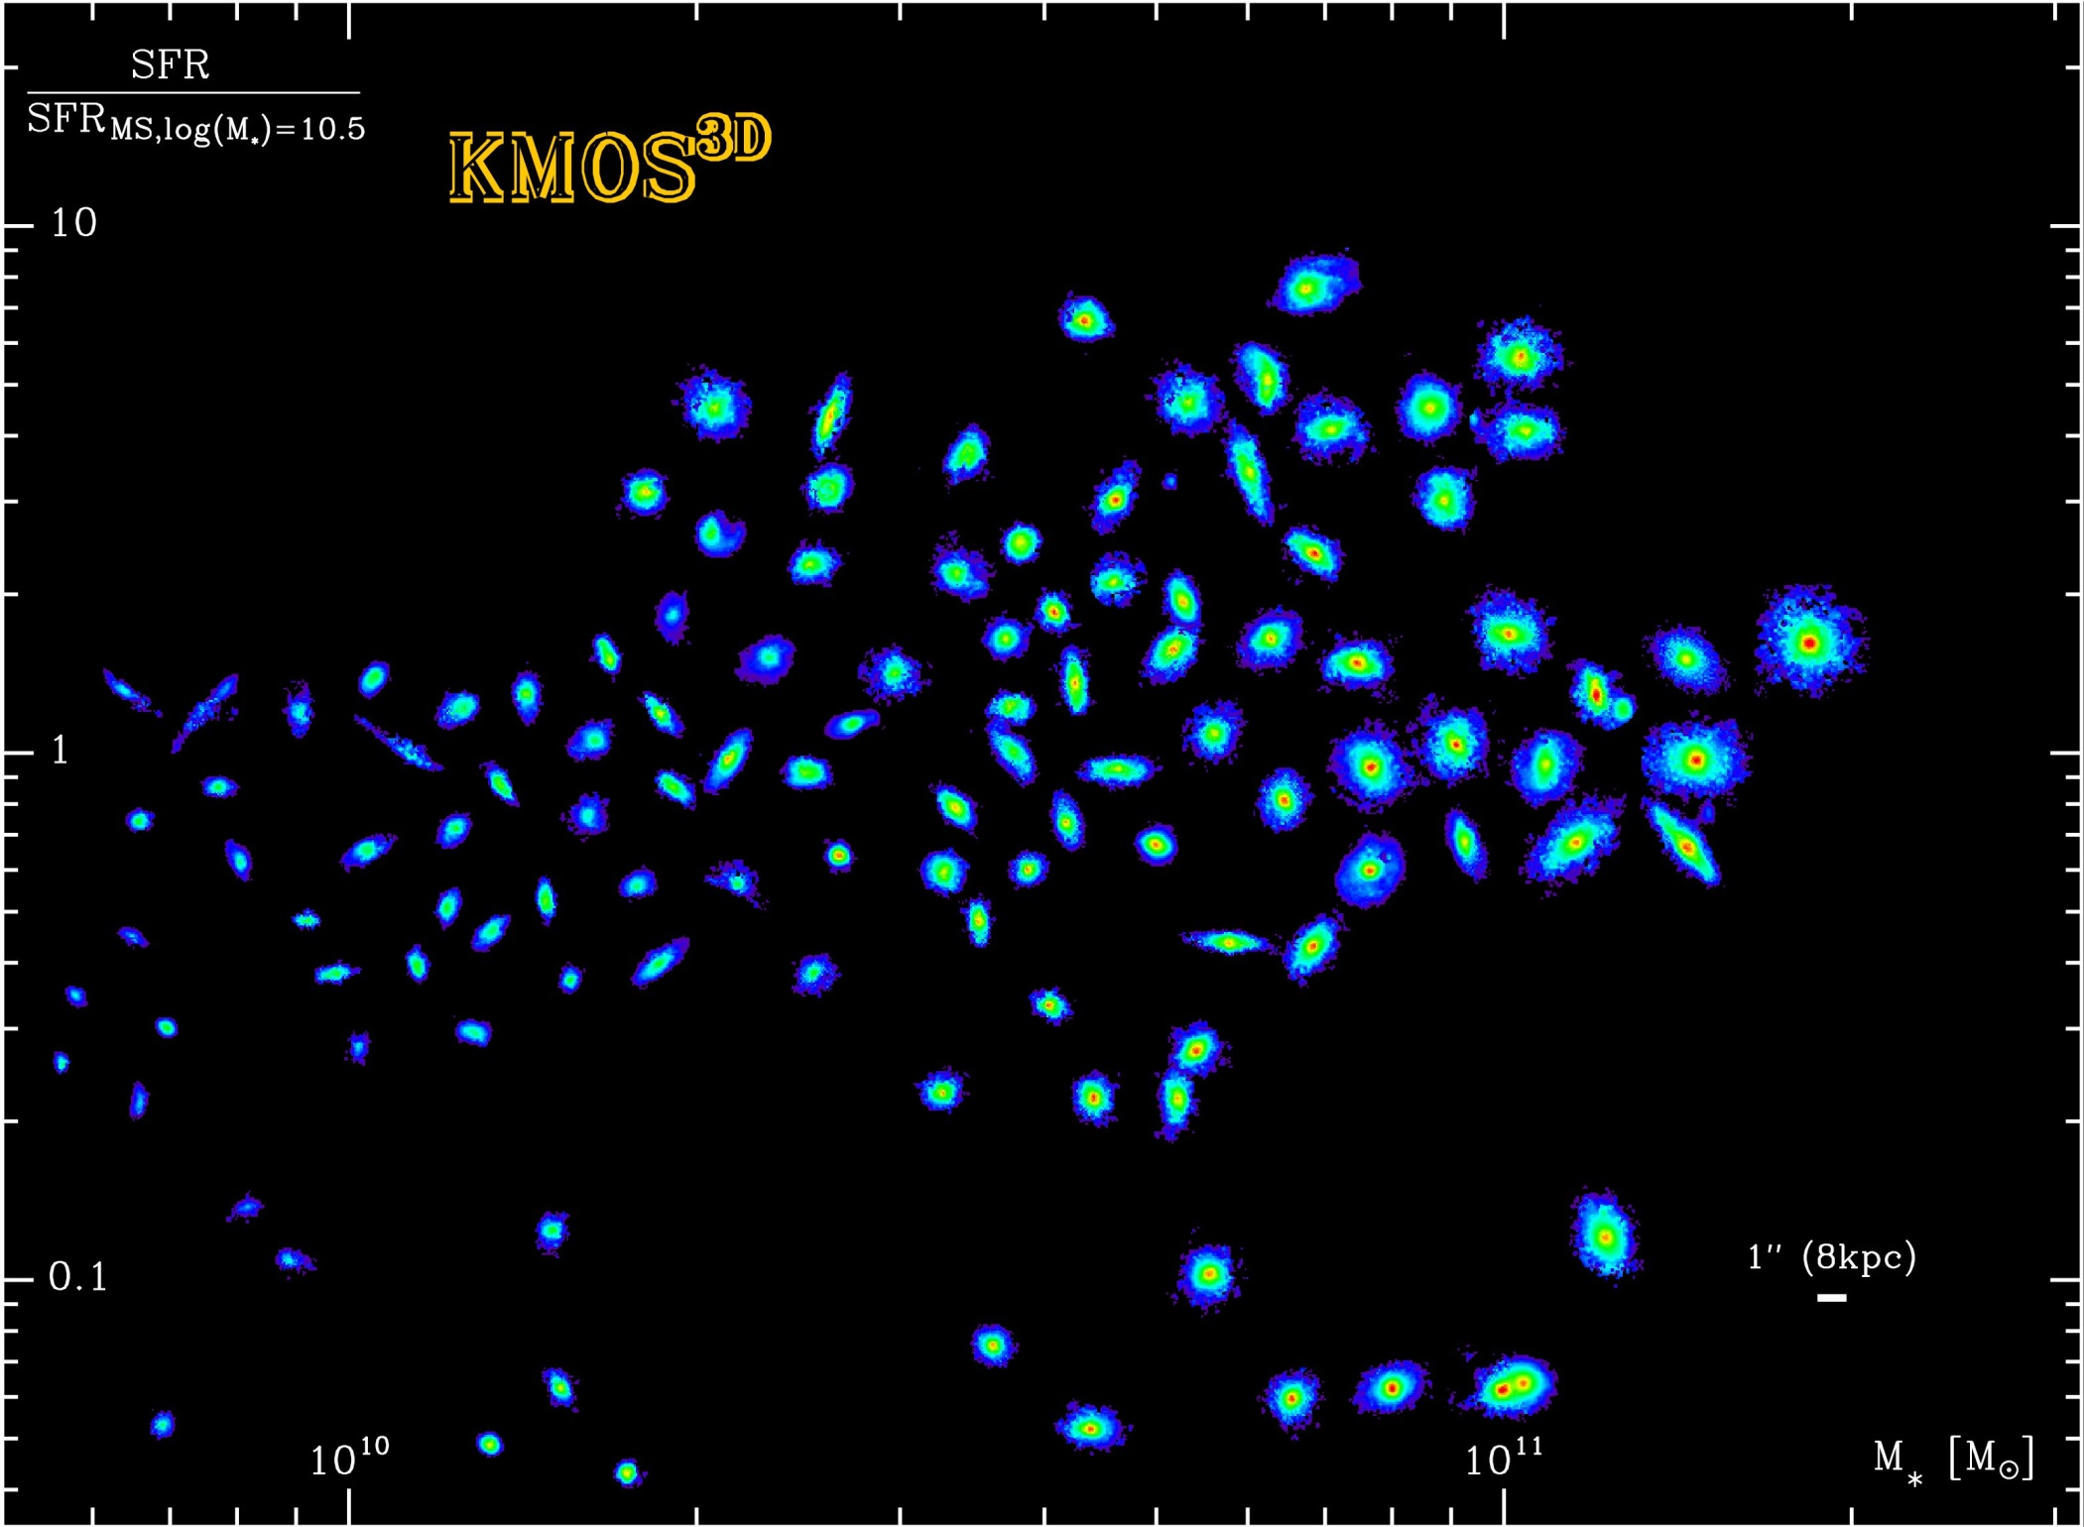
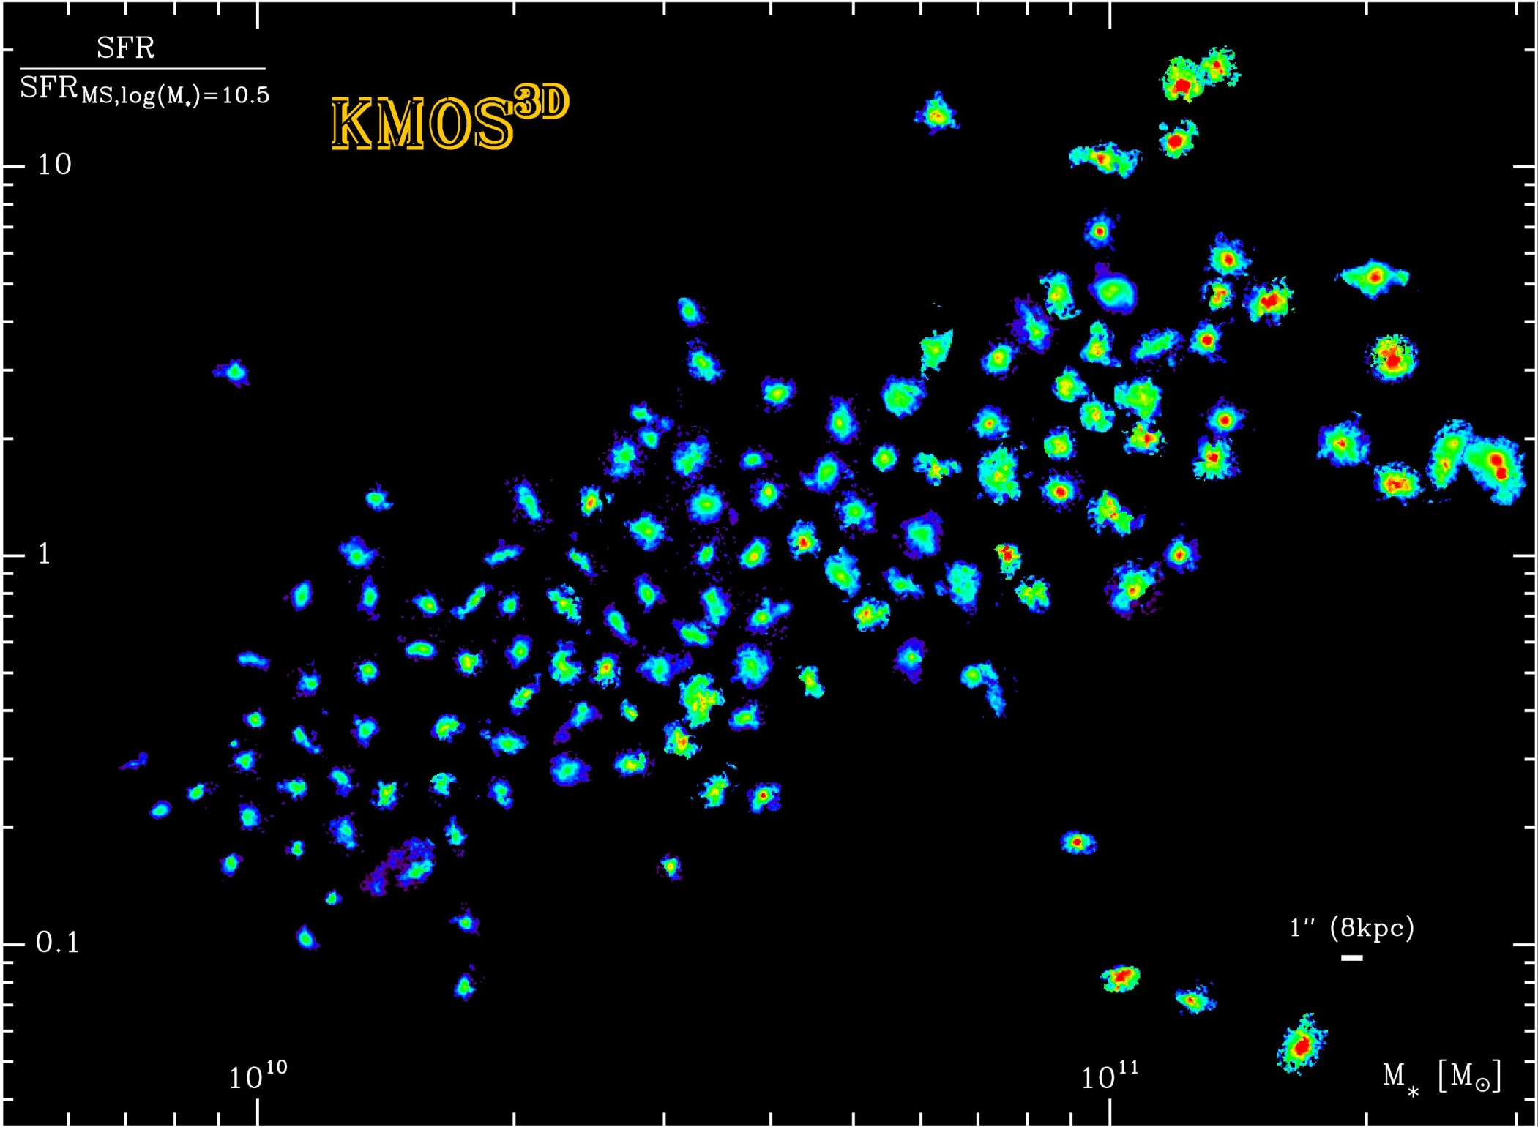
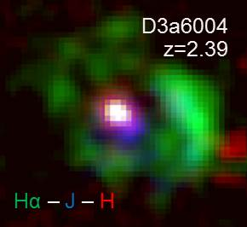
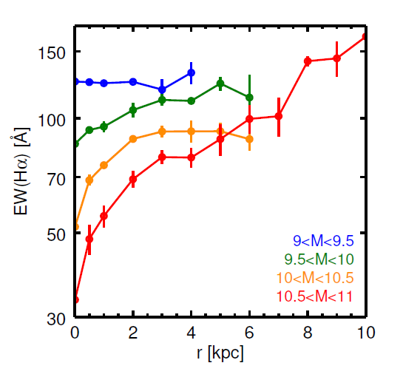
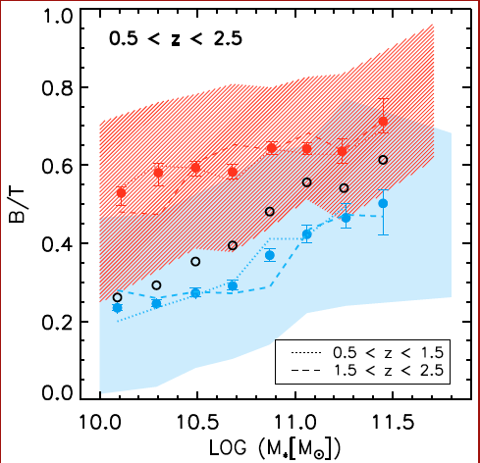
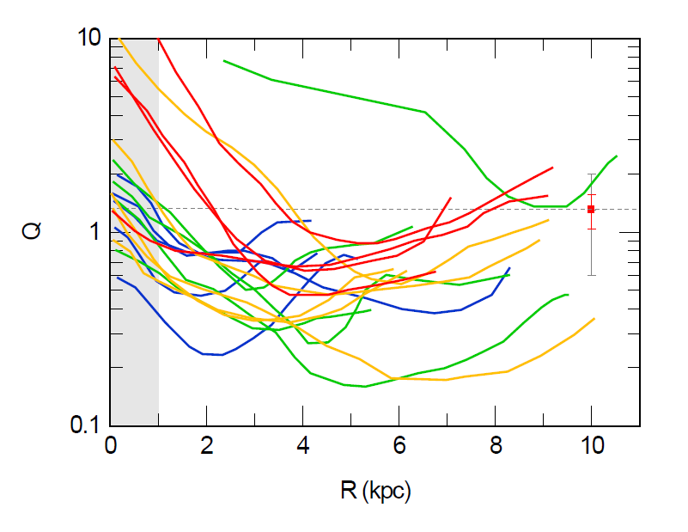
KMOS-3D
Stellar Structure of z ~ 1 – 3 SFGs
Smooth(er) stellar mass distributions,
bulge growth and inside-out quenching
M HST/CANDELS
Σ(M*)
Σ(M*)
Quiescent
Q = $\frac{σκ}{πGΣ}$
3D-HST/CANDELS
Star-forming
Nelson+15
SINFONI+AO
Lang+2014
Genzel+14a
Wuyts+12; Lang+14 ⎯ Wuyts+13; Nelson+13,15; Genzel+14a; Tacchella+15a.b
And e.g. Kauffmann+03,06;Schiminovich+07;Bell+08,12;Cheung+12;Bruce+12,14;Fang+13;Bluck+14 ; Hunter+98;Martig+09,13;Saintonge+12;Crocker+12

Slide 8
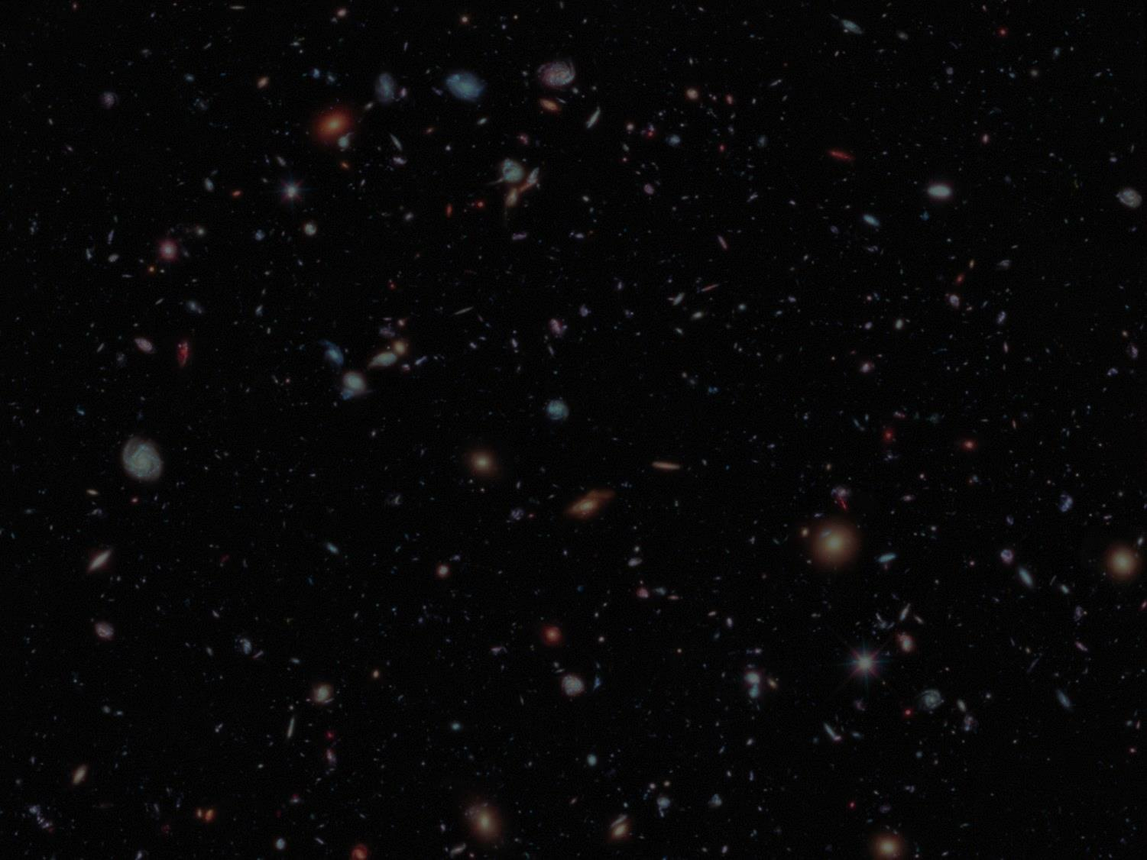
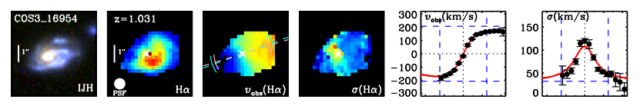
KMOS-3D
Angular Momenta
Wisnioski +15
Implies <j_{baryon}> ~ <j_{DM}>
300 log(M) > 9.7, 0.8 < z < 2.6 SFGs
Burkert+15, Fall & Romanowsky 13, Dutton +10
Burkert+15
From KMOS3D/SINS, with additional MASSIV/OSIRIS/HiZELs data from Epinat+09,12; Vergani+12; Law+09,12; Wright+09; Swinbank+12a,b
Also, e.g., NFW+97; Mo+98; Bullock+01; Sofue&Rubin01; Hetznecker+06; Courteau+07; Burkert+10; van der Kruit&Freeman11; Barnabè+12;
Bovy&Rix13; Moster+13; Dutton+10, 13; Cappellari+13; Dekel&Burkert14; Übler+14; Genel+14; Courteau&Dutton15; Fall & Romanowski 2013

Slide 9
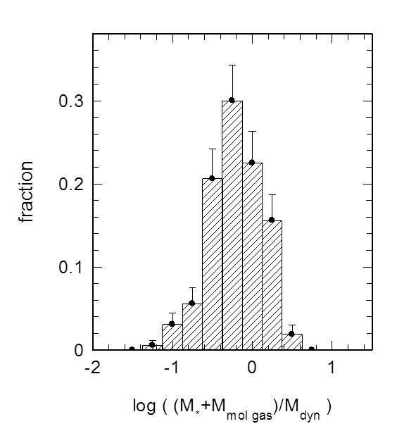
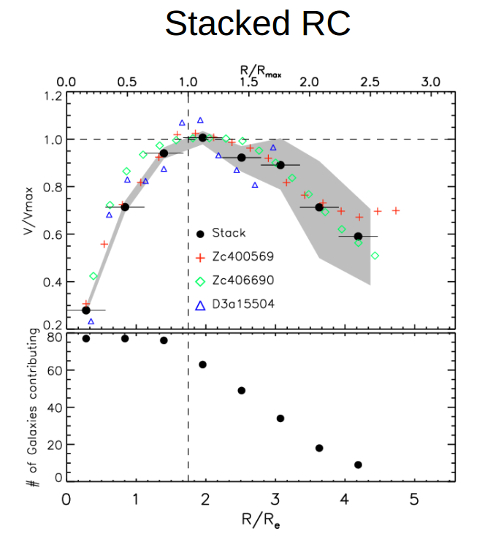
KMOS-3D
Baryon Fraction and Outer Disk Structure
 Inner regions of z ~ 1 – 2.5 disks strongly baryon-dominated
 Falling outer rotation curves ― pressure-driven disk “truncation”?
λ(baryons) ~ λ(DM)
<b> = 0.75 ± 0.12
Stack of ~100 log(M) > 9.7, 0.8 < z < 2.6 SFGs
300 log(M) > 9.3, 0.8 < z < 2.6 SFGs
Lang +16
Wuyts+15 / Burkert+15
From KMOS3D/SINS, with additional MASSIV/OSIRIS/HiZELs data from Epinat+09,12; Vergani+12; Law+09,12; Wright+09; Swinbank+12a,b
Also, e.g., NFW+97; Mo+98; Bullock+01; Sofue&Rubin01; Hetznecker+06; Courteau+07; Burkert+10; van der Kruit&Freeman11; Barnabè+12;
Bovy&Rix13; Moster+13; Dutton+13; Cappellari+13; Dekel&Burkert14; Übler+14; Genel+14; Courteau&Dutton15; and many more

Slide 10
KMOS-3D
Baryon Fraction
Burkert et al. 2015, Behroozi et al. 2009, 2012, Moster et al. 2013

Slide 11
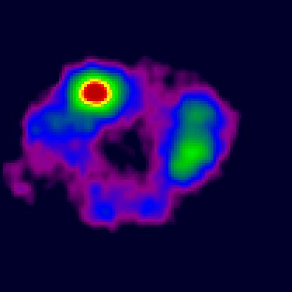
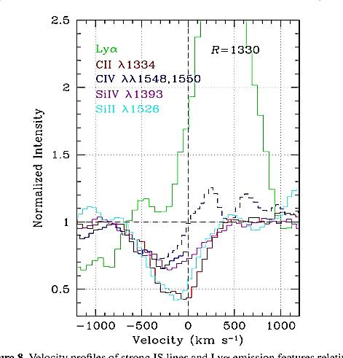
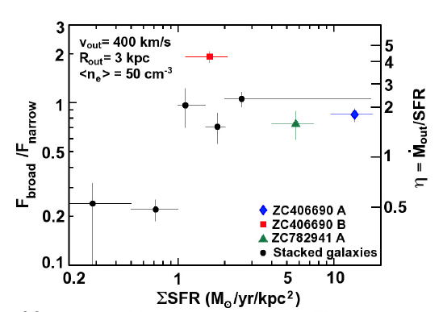
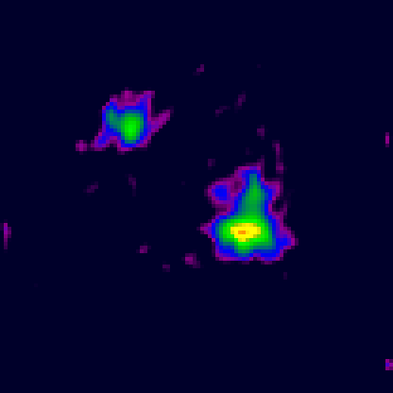

KMOS-3D
Feedback from Star Formation
SINFONI+AO
 FWHM ~ 450 km/s
 dM_{out}/dt (ionized gas) ~ 1 – 5× SFRs
 Breakout at Σ(SFR) $≳$ 1 M/yr/kpc²
Hα narrow – Star formation
Rest-UV ISM lines
B
Star
formation
Outflow
Hα broad – Outflow
Stacked pixels
Steidel+10
1” (8kpc)
Genzel+11; Newman+12a,b; Shapiro+09
Also, Pettini+00; Heckman+03,15; Shapley+03;Weiner+09; Steidel+10; Coil+11; Kulas+11; Law+12b; Kornei+12; Chen+12; Martin+05;
Rupke+02–13; Sharp,Bland-Hawthorn10; Sturm+11; Westmoquette+12,13; Bouché+12,14; RodríguezZaurín+13; Cicone+14; and many others

Slide 12
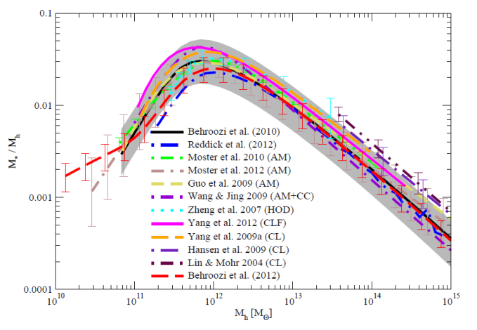
Stellar feedback: mass loading
breakout:
z=0: Σ_{SF}=0.1 My⁻¹kpc⁻²
z=2: Σ_{SF}=1 My⁻¹kpc⁻²
drop of M*/M_{halo} at low M_{halo},
and mass-metallicity relation:
stellar feedback with η~M*^{-1/3…-2/3}
Newman et al. 2012, Chen et al. 2012, Heckman 2003, Shetty & E. Ostriker 2012
Behroozi et al. 2012, 2013, Moster et al. 2013, Dave et al. 2011, 2012, Lilly et al. 2013, Erb et al. 2006, 2008
22 AO SINS/ZC SFGs: Newman et al. 2012b

Slide 13
Widespread Nuclear Outflows
KMOS-3D
z=0.8-2.6 GOODS S/N, UDF, COSMOS
450 M* & M*-SFR selected
SFGs z=0.76-2.6
sSFR/sSFR(ms,z)
broad nuclear component present in [NII], [SII] & resolved: R~1.5-3 kpc
→ outflow v_{out}~1000 km/s
logM*
nucleus, narrow component removed, grey= outer disk
4000 km/s
Förster Schreiber et al. 2014, Genzel et al. 2014b

Slide 14
KMOS-3D
Incidence of broad nuclear components and AGN
broad Hα/[NII]/[SII] (320 SFGs)
broad Hα/[NII]/[SII]
AGN (X-ray, IR, radio, optical)
GOODS
high duty cycle
dM/dt |_{nucleus}~SFR
v_{outflow} dM/dt |_{nucleus}~ 20 L/c
V_{outflow}>v_{escape}
COSMOS
Förster Schreiber et al. 2014, Genzel et al. 2014b, Brusa et al. 2015, Balmaverde et al. 2015

